Slide 1
In partnership with:

Slide 2
Stand Up for Safety Week is dedicated to creating time to discuss hazards working onshore and preventative measures that could be taken to reduce risk to health and safety.
#StandUpForSafety

Slide 3
About SafetyOn
Inspiring a safer and healthier onshore wind industry.
Providing advice, sharing best industry practice, promoting, innovation and creating positive change in the UK and Ireland’s onshore wind industry
Notes:
Provide health and safety leadership across the onshore wind industry
Seek participation of companies from across the onshore wind industry and partner with relevant trade organisations, consultancies and others
Monitor and gather data on the health and safety performance of the industry
Make use of and ensure effective communication of new and existing good practice and experience both from the UK, Ireland and internationally
Share knowledge and good practice with associated industries, including offshore wind, conventional generation and power networks, in the UK, Ireland and beyond as appropriate

Slide 4
Toppling cranes
#StandUpForSafety

Slide 5
Toolbox Talk
1. What happened?
Notes:
Crane toppled over
Load was not within the maximum lifting capacity of the crane

Slide 6
Toolbox Talk
2. Why did it happen?
Notes:
Load was not within the maximum lifting capacity of the crane.

Slide 7
Toolbox Talk
3. What did they learn?
Notes:
Be aware of short legging. Mitigate the risk by moving obstructions out of the way or replanning the lift location.
A qualified person should inspect and ensure the ground is sufficiently stable. Extra matting could be used to spread the load.

Slide 8
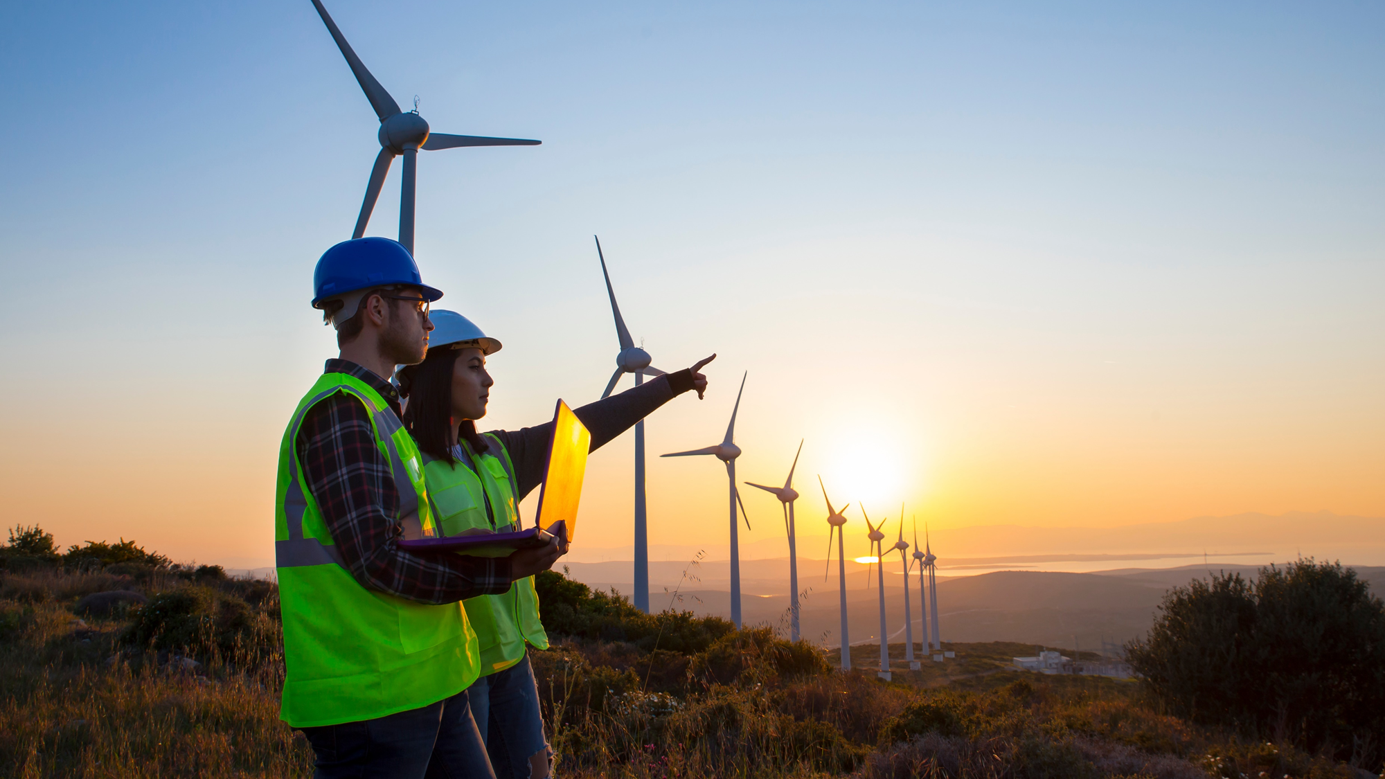
Toolbox Talk
4. Ask yourself or your crew?
Notes:
How can you check that the load is within the maximum lifting capacity of the crane?
What can you change (e.g. to the site layout or working conditions to prevent short legging?
How do you know that the ground is stable? What should you do if it isn’t?
What other risks or hazards do we need to consider in crane lifting operations?

Slide 9
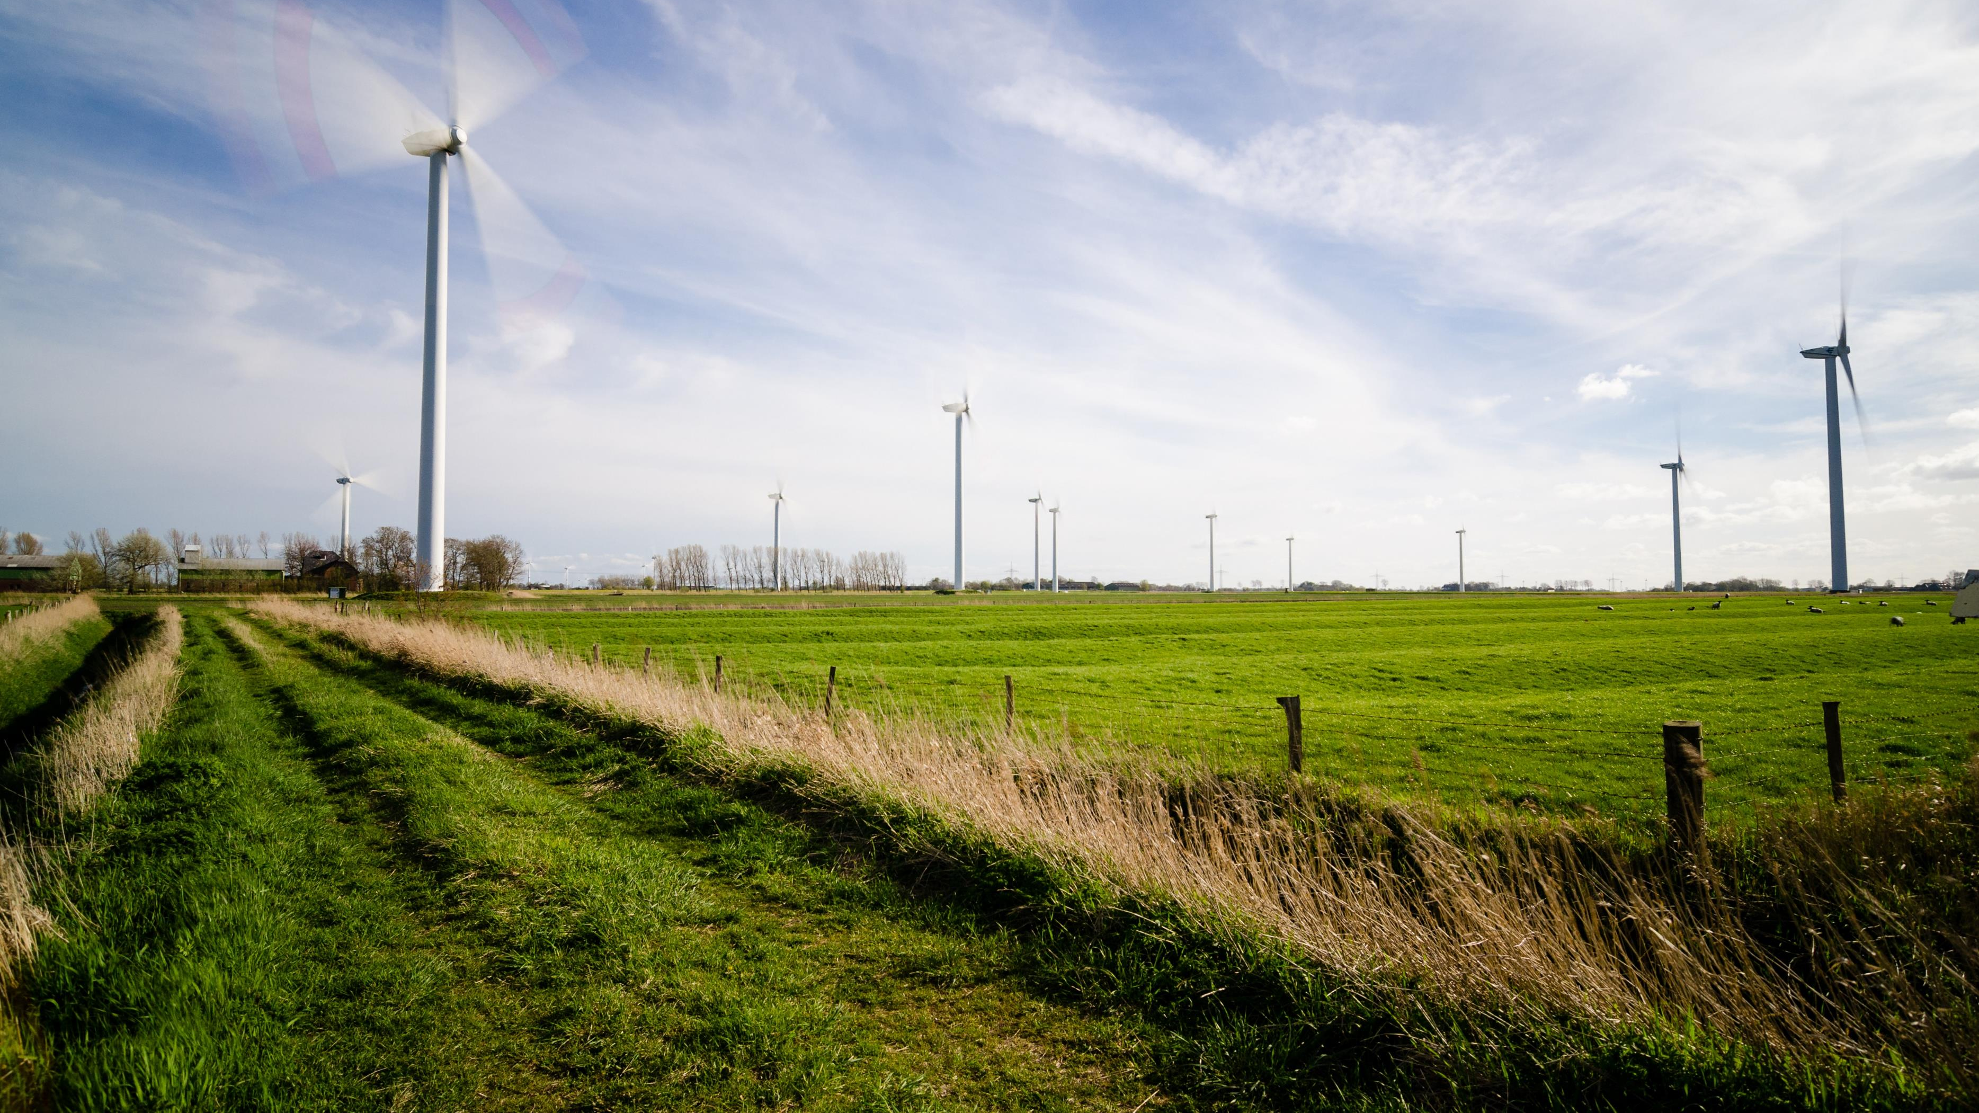
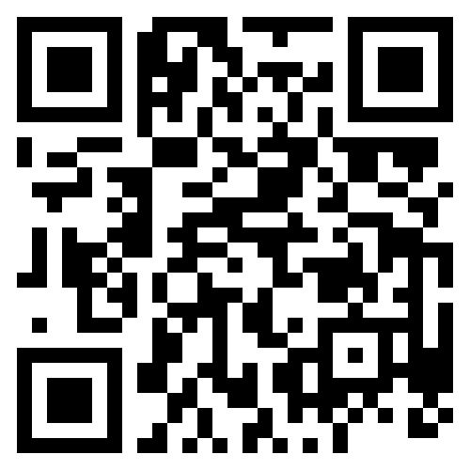
Find out more
www.safetyon.com
Sign up for our newsletter:
#StandUpForSafety

