Slide 1


In partnership with:

Slide 2


Stand Up for Safety Week is dedicated to creating time to discuss hazards working onshore and preventative measures that could be taken to reduce risk to health and safety.
#StandUpForSafety

Slide 3



About SafetyOn
Inspiring a safer and healthier onshore wind industry.
Providing advice, sharing best industry practice, promoting, innovation and creating positive change in the UK and Ireland’s onshore wind industry
Notes:
Provide health and safety leadership across the onshore wind industry
Seek participation of companies from across the onshore wind industry and partner with relevant trade organisations, consultancies and others
Monitor and gather data on the health and safety performance of the industry
Make use of and ensure effective communication of new and existing good practice and experience both from the UK, Ireland and internationally
Share knowledge and good practice with associated industries, including offshore wind, conventional generation and power networks, in the UK, Ireland and beyond as appropriate

Slide 4

The Power of Example
#StandUpForSafety

Slide 5
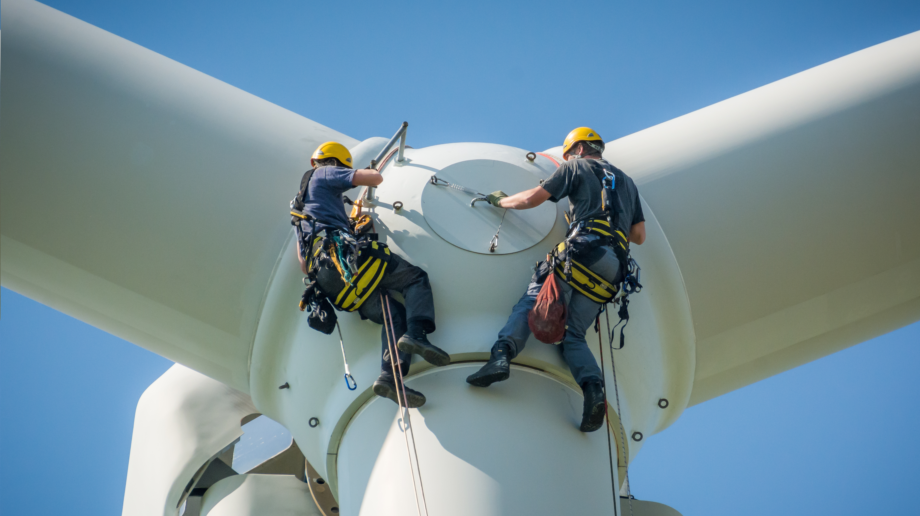

Toolbox Talk
1. What happened?
Notes:
The example you set influences others. Watch a real-life example. A man crosses a railroad crossing and is followed by his friend.
A Veteran operator catches a sample. He has done this same task for 35 years. The Veteran was not wearing a face shield and was wearing incorrect PPE. Veteran operator ignores a barricade.

Slide 6

Toolbox Talk
2. Why did it happen?
Notes:
A bad example was set which was followed by others

Slide 7
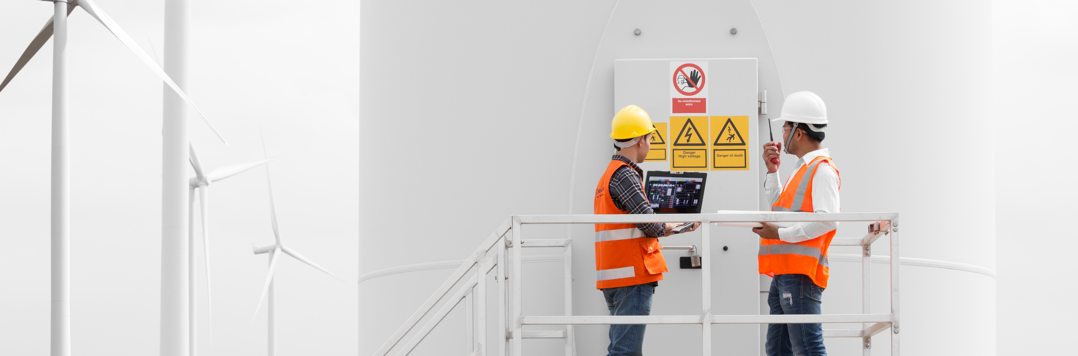
Toolbox Talk
3. What did they learn?
Notes:
The power of example
Ensuring a good example is set to influence others
Your example influences other’s behaviour

Slide 8
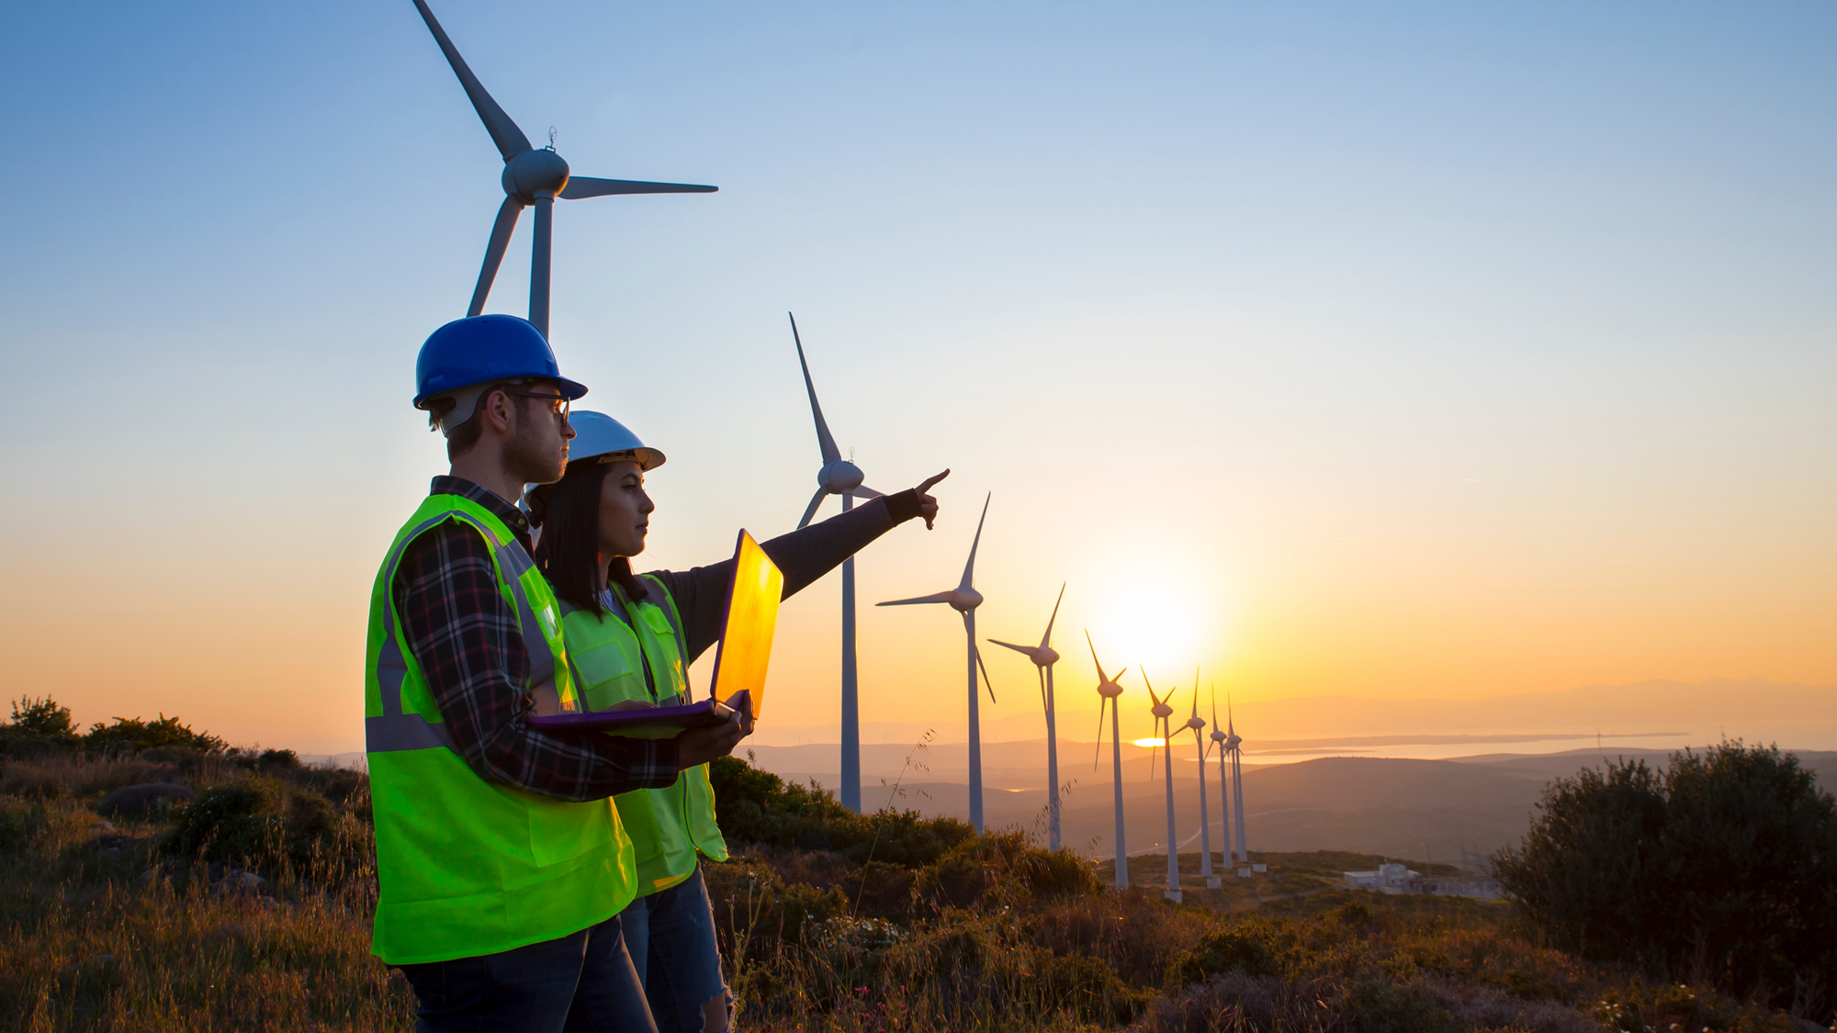
Toolbox Talk
4. Ask yourself or your crew?
Notes:
Think of a time when you were influenced by someone else’s behaviour. What happened?
What would you change?

Slide 9
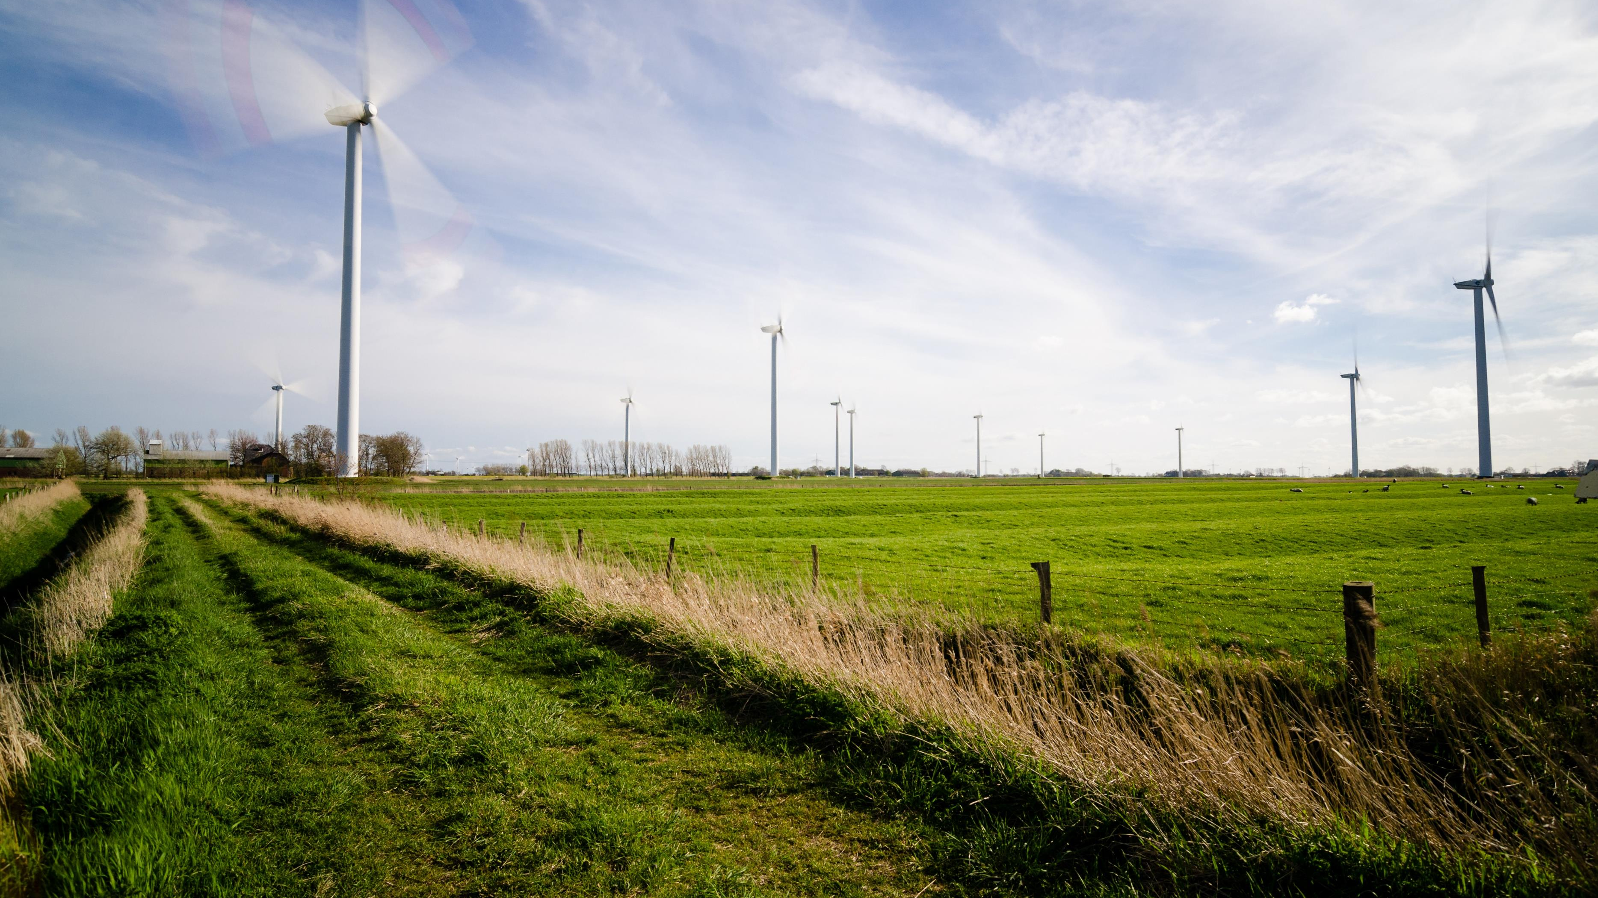
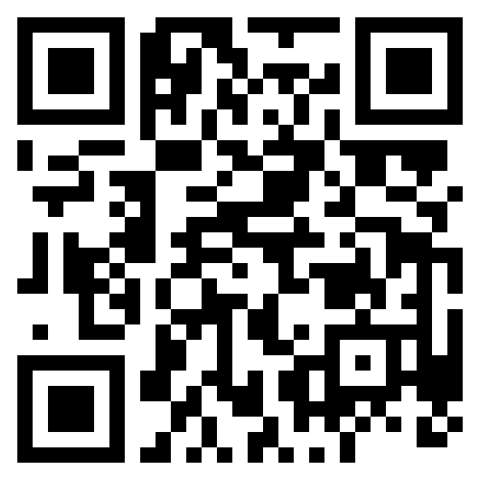
Find out more
www.safetyon.com
Sign up for our newsletter:
#StandUpForSafety

