Slide 1
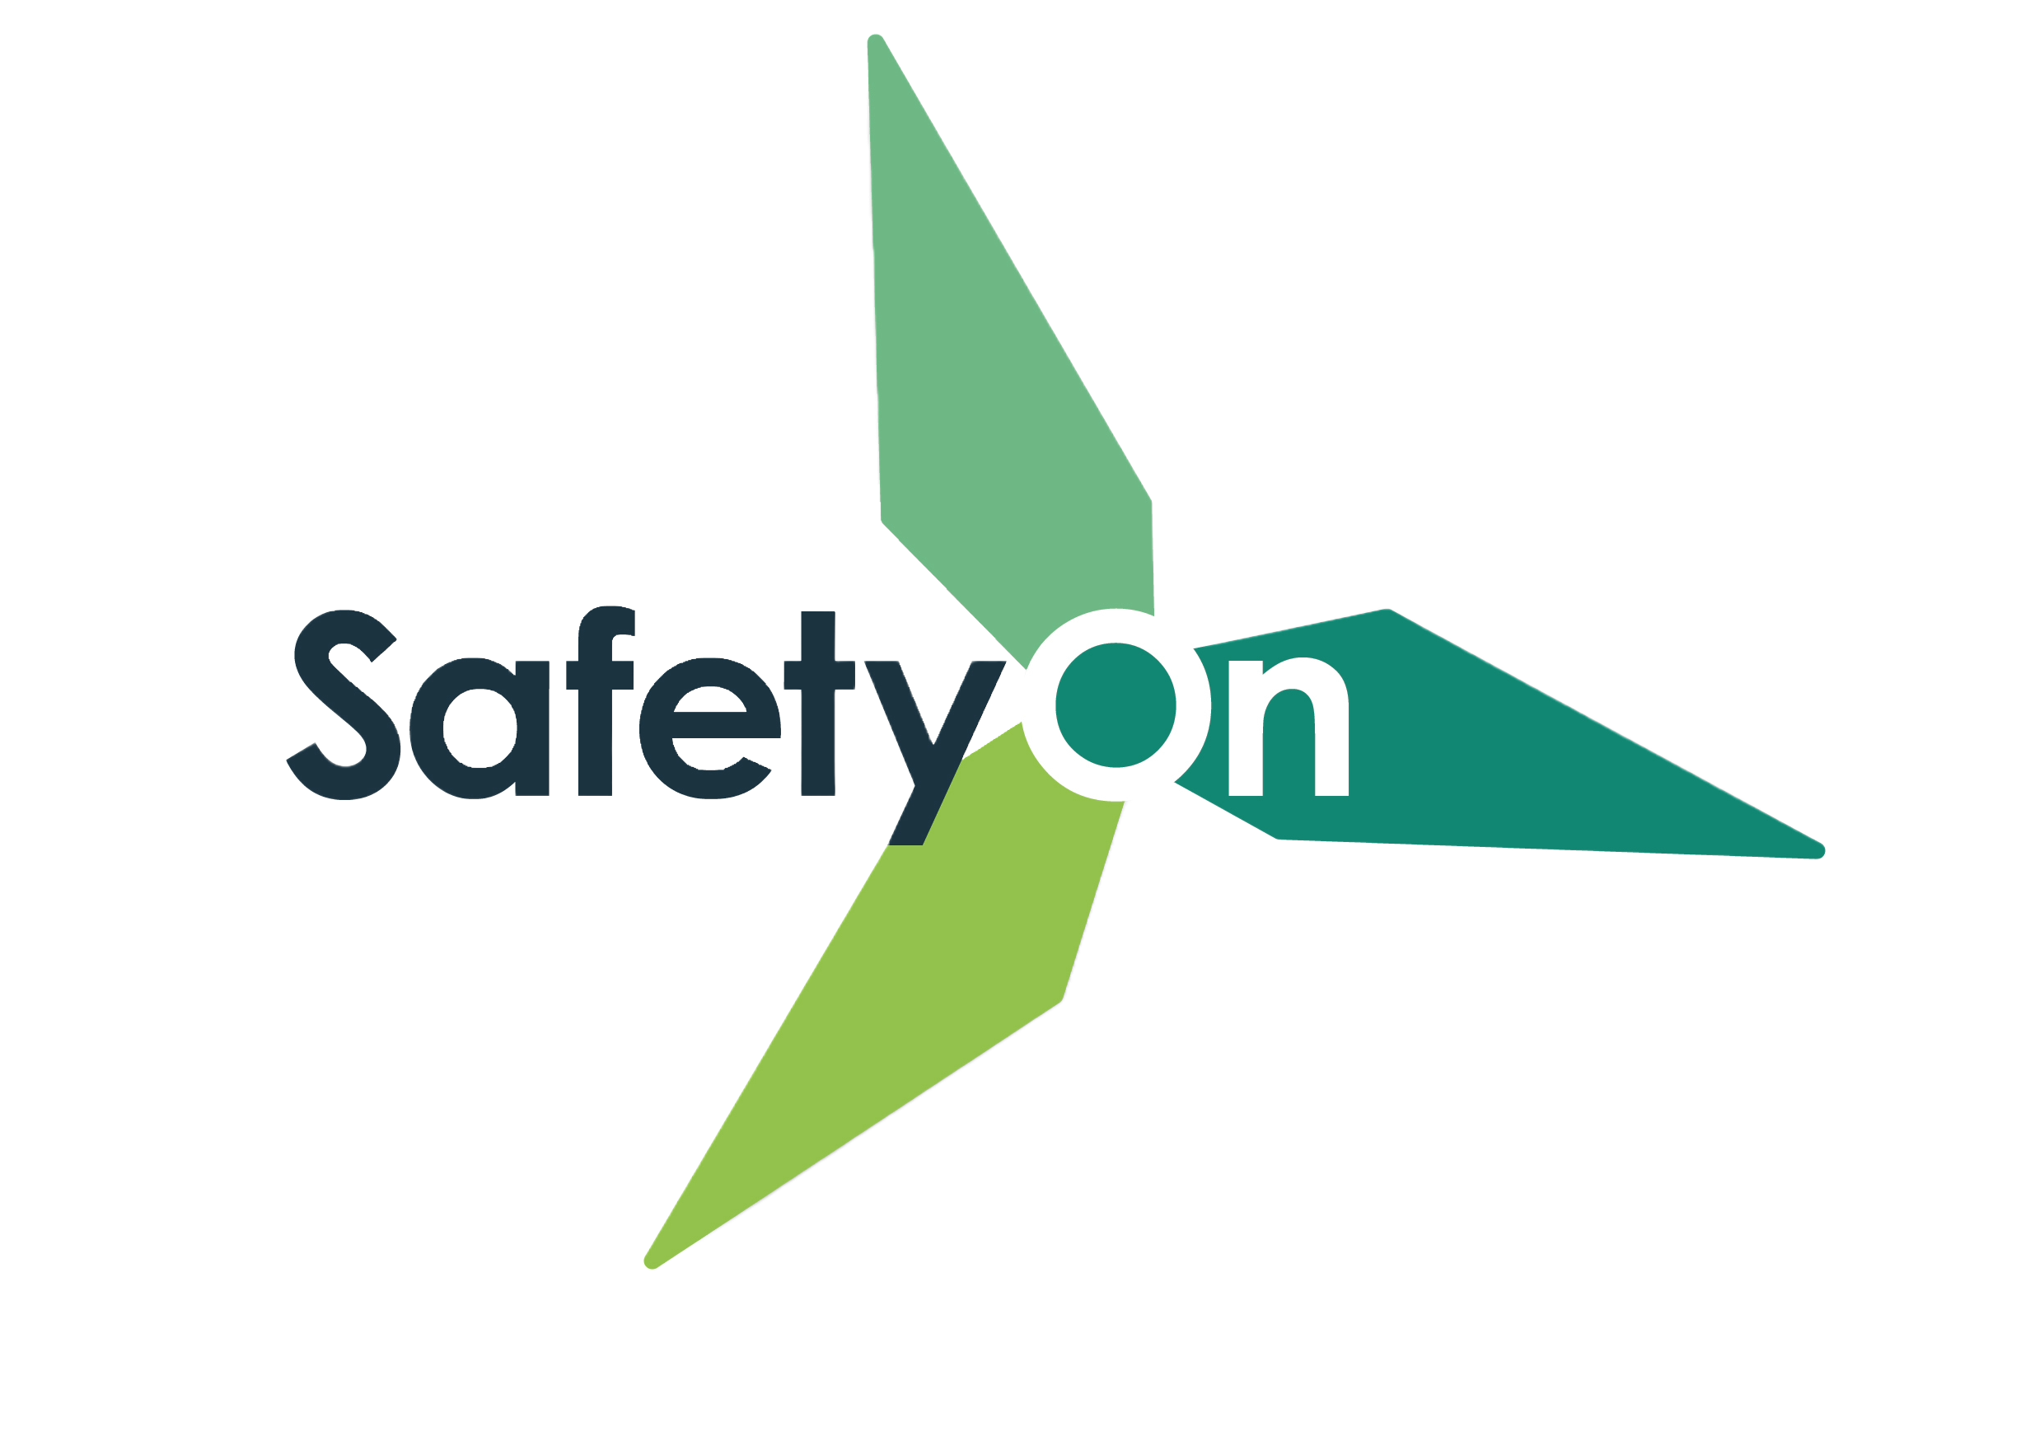
Addressing Manual Handling in the Wind Industry
Toolbox Talk 4: Risk assessment

Slide 2
About SafetyOn
About G+
Inspiring a safer and healthier onshore wind industry
Global Offshore Wind Health and Safety Organisation
Providing advice, sharing best industry practice, promoting, innovation and creating positive change in the UK and Ireland’s onshore wind industry
Driving world class health and safety performance through collaboration on incident reporting, good practice, improving design safety and sharing lessons from incidents
Find out more at safetyon.com
Find out more at gplusoffshorewind.com
Notes:
SafetyOn
Provide health and safety leadership across the onshore wind industry
Seek participation of companies from across the onshore wind industry and partner with relevant trade organisations, consultancies and others
Monitor and gather data on the health and safety performance of the industry
Make use of and ensure effective communication of new and existing good practice and experience both from the UK, Ireland and internationally
Share knowledge and good practice with associated industries, including offshore wind, conventional generation and power networks, in the UK, Ireland and beyond as appropriate
G+
G+ is the global health and safety organisation, bringing together the offshore wind industry to pursue shared goals and outcomes. It is run in partnership with the Energy Institute, which provides the secretariat and supports its work.
The G+ main work areas:
Incident data reporting
Good practice guidance
Safe by Design workshops
Learning from incidents
Wind Turbine Safety Rules
Lifesaving Rules

Slide 3
Why manual handling?
Manual handling encompasses a wide range of incidents, with many crossovers and misconceptions. It is the leading cause of injuries in the wind industry, both on and offshore.
This video campaign aims to illustrate these incidents, suggesting good practice, rooted on actual on-site experience and reflective of all phases of projects both for the onshore and offshore wind industry.

Slide 5
Risk assessment

Slide 6
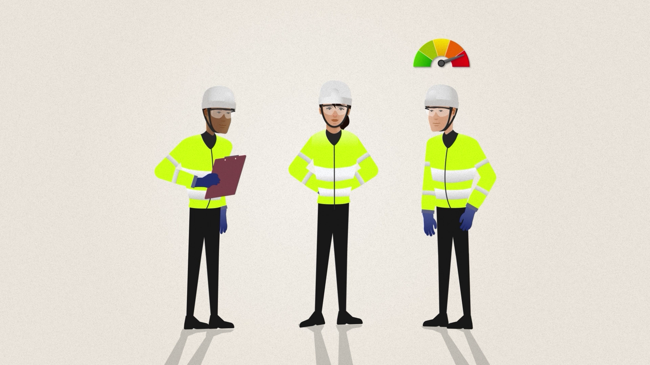
Toolbox Talk
Risk assessment
Where do you undertake dynamic risk assessments for manual handling tasks?
What external factors could increase the risk of a manual handling incident?
How might the manual handling risk differ between people, even for the same task?
When have you encouraged peers to stop and re-assess a manual handling risk?
Notes:
Additional questions to encourage discussion:
Think about your day-to-day tasks as well as the bigger risky jobs, do you get straight on with the job or stop and think first? What tasks come to mind?
How might the weather impact the risk of a task? What if the weather is great now but it has been raining? Other environmental factors? What about mental distractions, how might someone’s personal life increase their risk of a manual handling injury? Can fatigue impact the risk? What about the time of day or season?
Are we all built the same? How could previous injuries impact this risk? Think about how equipment is designed, is it suitable for all shapes and sizes? How can you look out for your peers in these scenarios?
Or, has a peer reminded you of manual handling risks? What did you say? What did they do? How did you feel? Would you feel comfortable doing this at work? How can we encourage a culture of positive reflection and correction in the workplace?

Slide 7
www.safetyon.com
@SafetyOnTweets
@SafetyOn
safetyon@energyinst.org
www.gplusoffshorewind.com
@gplusglobalofw
@G+ Global Offshore Wind Health and Safety Organisation
gplus@energyinst.org
Sign up for our newsletters

