Slide 1
In partnership with:

Slide 2
Stand Up for Safety Week is dedicated to creating time to discuss hazards working onshore and preventative measures that could be taken to reduce risk to health and safety.
#StandUpForSafety

Slide 3
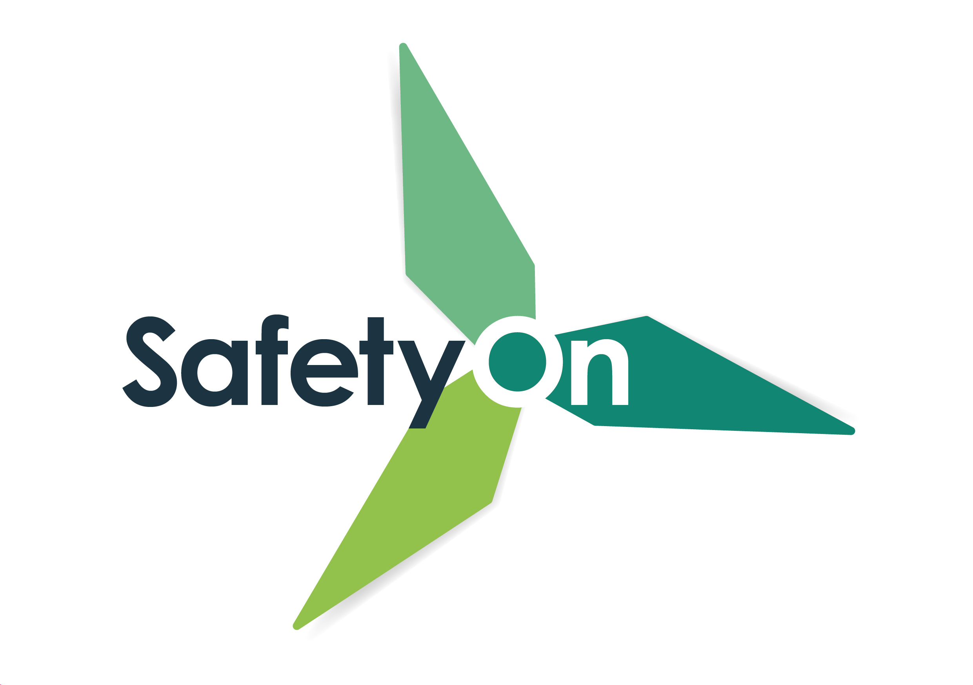
About SafetyOn
Inspiring a safer and healthier onshore wind industry
.
We work to:
Monitor and gather data on the health and safety performance of the sector
Make use of and ensure effective communication of new and existing good practice and experience both from the UK and internationally
Share knowledge and good practice with associated sectors, including offshore wind, conventional generation and power networks, in the UK and beyond as appropriate
Notes:
Provide health and safety leadership across the onshore wind sector
Seek participation of companies from across the onshore wind sector and partner with relevant trade organisations, consultancies and others
Monitor and gather data on the health and safety performance of the sector
Make use of and ensure effective communication of new and existing good practice and experience both from the UK and internationally
Share knowledge and good practice with associated sectors, including offshore wind, conventional generation and power networks, in the UK and beyond as appropriate

Slide 4
Safe Wiring Campaign
#StandUpForSafety
Notes:
https://toolbox.energyinst.org/c/videos/non-isolated-hanging-electrical-wire-causes-electric-shock-during-painting

Slide 5
Toolbox Talk
1. What happened?
Notes:
A maintenance contractor was painting the exterior wall of a service station.
Above the wall, a tube light frame had been removed as it damaged during a storm. The electrical wires were left hanging down the wall.
The contractor’s shoulder touched the end of the electrical wire.
He felt electricity run down his right arm and jumped off the ladder (3ft/1m).
He suffered temporary numbness and was given 2 days rest.

Slide 6
Toolbox Talk
2. Why did it happen?
Notes:
A hanging wire was not isolated.
Even though the switch was off, the wire was still live.
Physical isolation was not verified by the contractors, who relied on the word of the site personnel.
Lack of knowledge of work control procedures and work permit system for working on energised systems. This was a non-routine activity, but no special permit was issued.
Lack of communication between contractor, site representative, maintenance coordinator and project engineering.
Lack of management and oversight of task by contractor management.

Slide 7
Toolbox Talk
3. What did they learn?
Notes:
Verify the status and energy of electrical cables. Isolate them where required.
Do not start work without checking that the power supply has been rendered inoperative.
Even if the task seems low risk and does not involve working on a powered system, ensure all hazards are eliminated/mitigated before starting work.
Conduct work using a valid work permit. If permits are issued in an office, review, verify and re-validate permits upon arrival on site.
Ensure there is good communication between contractors, engineers, maintenance and other departments.

Slide 8
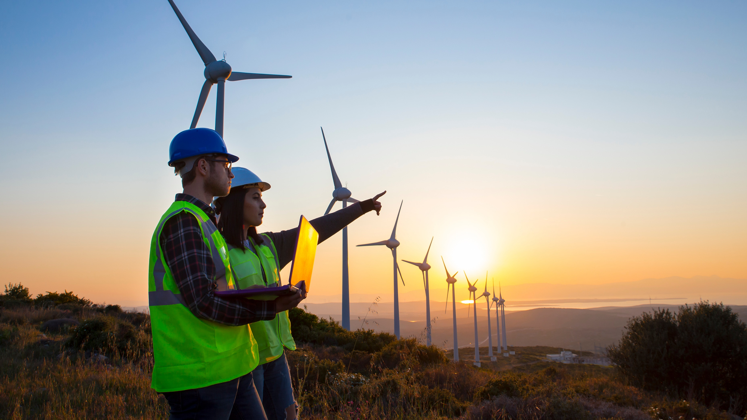
Toolbox Talk
4. Ask yourself or your crew?
Notes:
How can something like this happen here?
How can you verify if the energy supply is isolated before starting work?
What can we do to improve communication between contractors and site personnel?
Have we verified the permit on-site? Does it accurately reflect the task?
What else can we learn from this incident?

