Slide 1
Addressing Manual Handling in the Wind Industry
Toolbox Talk 2: The incident

Slide 2
About SafetyOn
About G+
Inspiring a safer and healthier onshore wind industry
Global Offshore Wind Health and Safety Organisation
Providing advice, sharing best industry practice, promoting, innovation and creating positive change in the UK and Ireland’s onshore wind industry
Driving world class health and safety performance through collaboration on incident reporting, good practice, improving design safety and sharing lessons from incidents
Find out more at safetyon.com
Find out more at gplusoffshorewind.com
Notes:
SafetyOn
Provide health and safety leadership across the onshore wind industry
Seek participation of companies from across the onshore wind industry and partner with relevant trade organisations, consultancies and others
Monitor and gather data on the health and safety performance of the industry
Make use of and ensure effective communication of new and existing good practice and experience both from the UK, Ireland and internationally
Share knowledge and good practice with associated industries, including offshore wind, conventional generation and power networks, in the UK, Ireland and beyond as appropriate
G+
G+ is the global health and safety organisation, bringing together the offshore wind industry to pursue shared goals and outcomes. It is run in partnership with the Energy Institute, which provides the secretariat and supports its work.
The G+ main work areas:
Incident data reporting
Good practice guidance
Safe by Design workshops
Learning from incidents
Wind Turbine Safety Rules
Lifesaving Rules

Slide 3
Why manual handling?
Manual handling encompasses a wide range of incidents, with many crossovers and misconceptions. It is the leading cause of injuries in the wind industry, both on and offshore.
This video campaign aims to illustrate these incidents, suggesting good practice, rooted on actual on-site experience and reflective of all phases of projects both for the onshore and offshore wind industry.

Slide 5
The incident

Slide 6
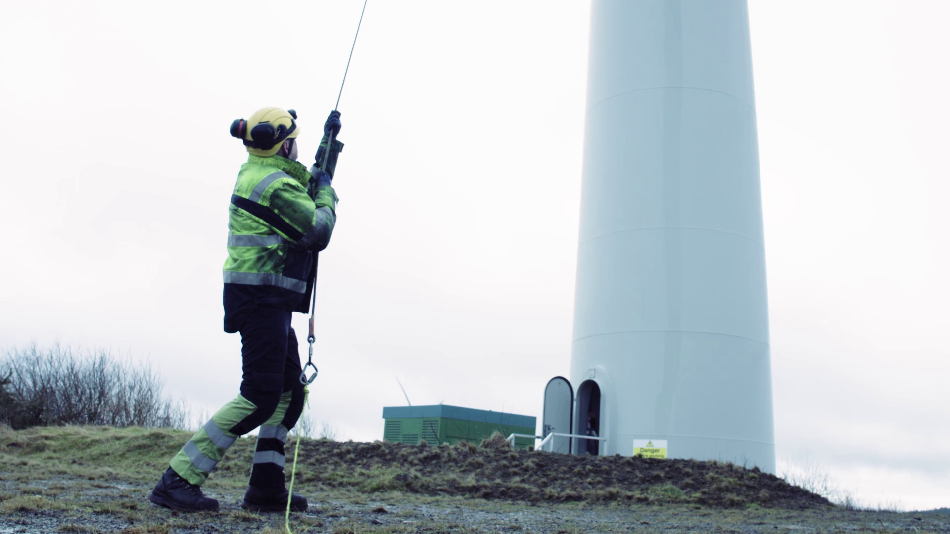
Toolbox Talk
The incident
1. What happened?
Notes:
Further discussion questions:
What was the context?
How do you think Ian felt when he failed his medical, why?
Short-term?
Long-term?
Could this happen to you/someone in your team?

Slide 7
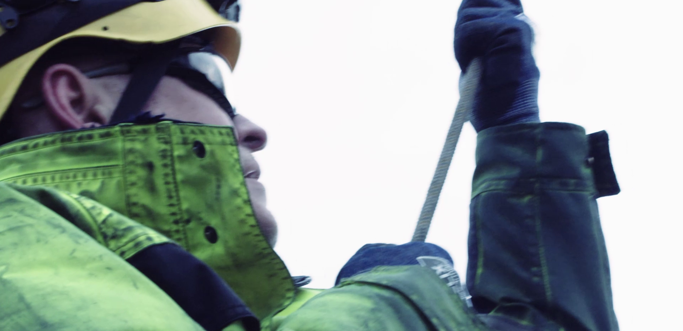
Toolbox Talk
The incident
2. Why did it happen?
Notes:
Further discussion questions:
1. Were there external pressures? Time? Weather? Short-staffed? How could these factors have impacted the incident?

Slide 8
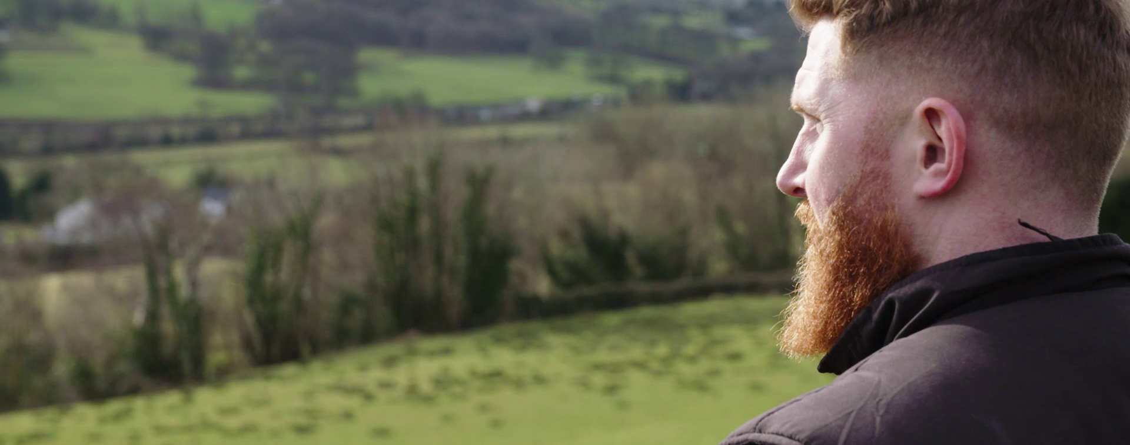
Toolbox Talk
The incident
3. What did they learn?
Notes:
Further discussion questions:
How could Ian's company and colleagues have supported him better at the time? Think, at the time of the incident, in the days/weeks after, when he failed his medical?
What could have been done to prevent this injury?

Slide 9
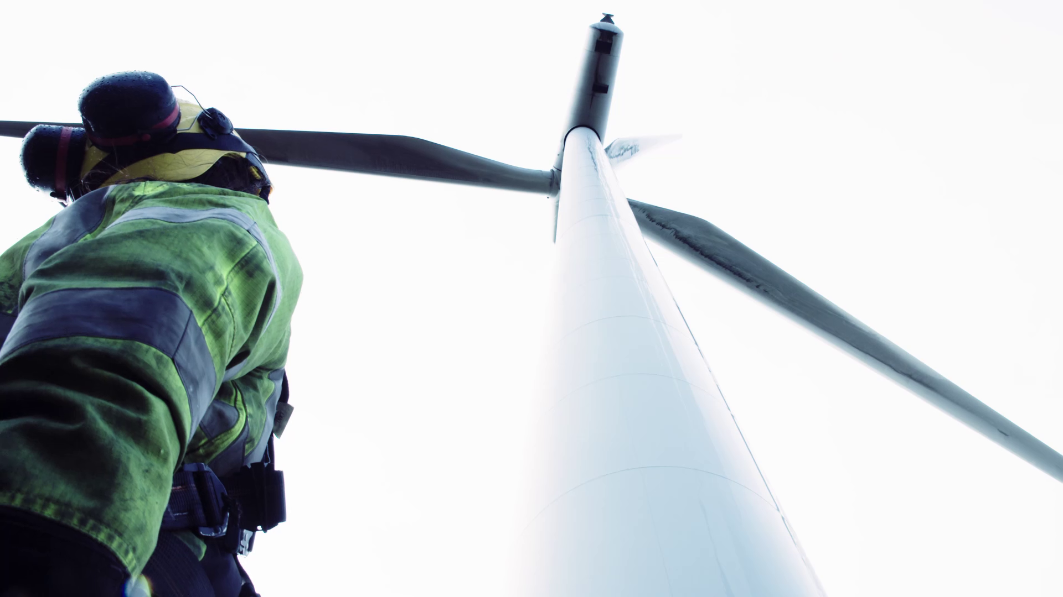
Toolbox Talk
The incident
4. Ask yourself or your crew?
Notes:
Further discussion questions:
Could this happen on-site?
How could it be prevented?
What should you look out for on-site to avoid this happening to you/your team?

Slide 10
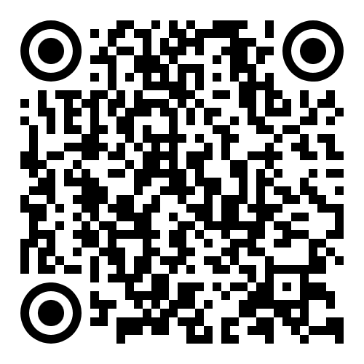
www.safetyon.com
@SafetyOnTweets
@SafetyOn
safetyon@energyinst.org
www.gplusoffshorewind.com
@gplusglobalofw
@G+ Global Offshore Wind Health and Safety Organisation
gplus@energyinst.org
Sign up for our newsletters

