Slide 1
Addressing Manual Handling in the Wind Industry
Toolbox Talk 1: What is Manual Handling?

Slide 2
About SafetyOn
About G+
Inspiring a safer and healthier onshore wind industry
Global Offshore Wind Health and Safety Organisation
Providing advice, sharing best industry practice, promoting, innovation and creating positive change in the UK and Ireland’s onshore wind industry
Driving world class health and safety performance through collaboration on incident reporting, good practice, improving design safety and sharing lessons from incidents
Find out more at safetyon.com
Find out more at gplusoffshorewind.com
Notes:
SafetyOn
Provide health and safety leadership across the onshore wind industry
Seek participation of companies from across the onshore wind industry and partner with relevant trade organisations, consultancies and others
Monitor and gather data on the health and safety performance of the industry
Make use of and ensure effective communication of new and existing good practice and experience both from the UK, Ireland and internationally
Share knowledge and good practice with associated industries, including offshore wind, conventional generation and power networks, in the UK, Ireland and beyond as appropriate
G+
G+ is the global health and safety organisation, bringing together the offshore wind industry to pursue shared goals and outcomes. It is run in partnership with the Energy Institute, which provides the secretariat and supports its work.
The G+ main work areas:
Incident data reporting
Good practice guidance
Safe by Design workshops
Learning from incidents
Wind Turbine Safety Rules
Lifesaving Rules

Slide 3
Why manual handling?
Manual handling encompasses a wide range of incidents, with many crossovers and misconceptions. It is the leading cause of injuries in the wind industry, both on and offshore.
This video campaign aims to illustrate these incidents, suggesting good practice, rooted on actual on-site experience and reflective of all phases of projects both for the onshore and offshore wind industry.

Slide 5
What is Manual Handling?

Slide 6
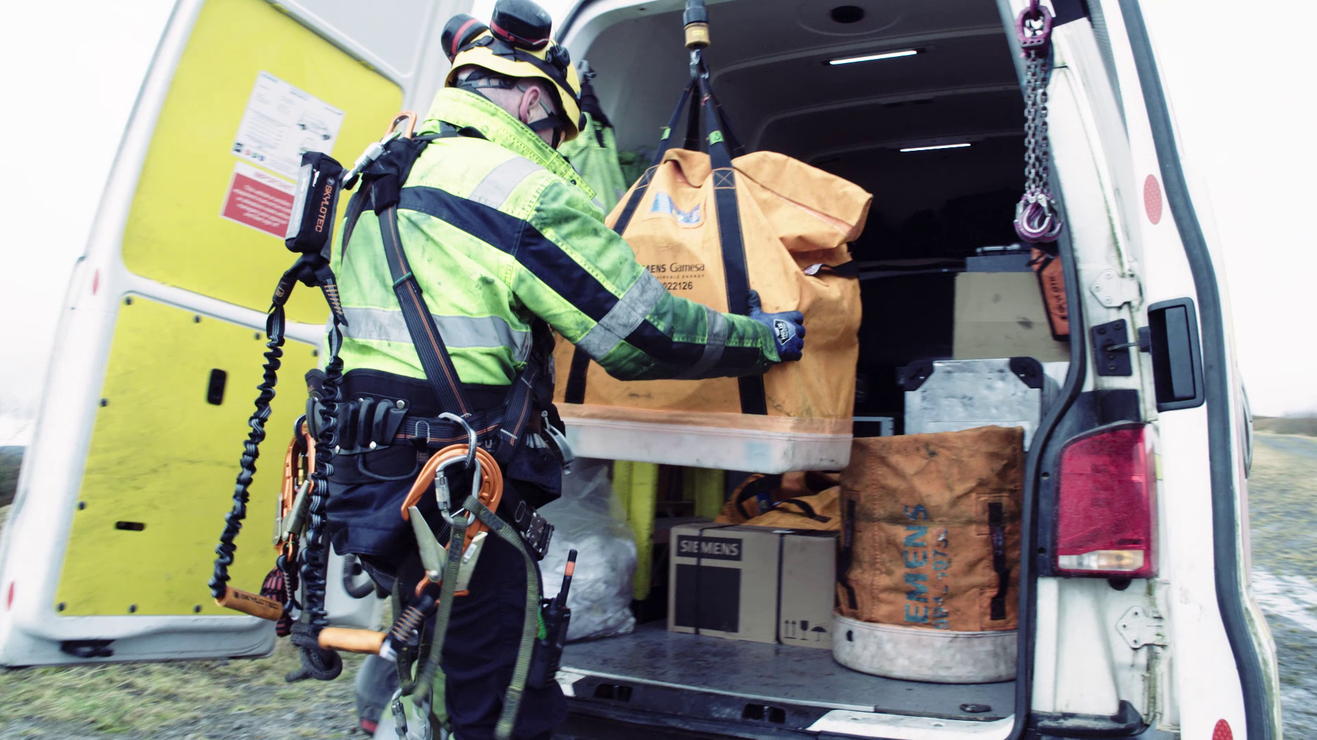
Toolbox Talk
What is Manual Handling?
Where do you encounter manual handling in your work tasks?
Why do you think it is the leading cause of injuries?
How can we keep each other safe regarding manual handling in the workplace?
What can be challenging about recognising and act on manual handling risks?
Have you ever experienced a manual handling injury, or a close call?
Notes:
Additional questions to encourage discussion:
Do you agree with their definitions of manual handling? What else would you add?
Why do you make considerations in your day-to-day? Do you have personal considerations?
What have you or others done to reduce potential manual handling incidents?
Have you seen this at work? How would a manual handling culture be reflected?
If a scenario is shared, the following slides “Toolbox Talk” could be used to discuss the incident.

Slide 7
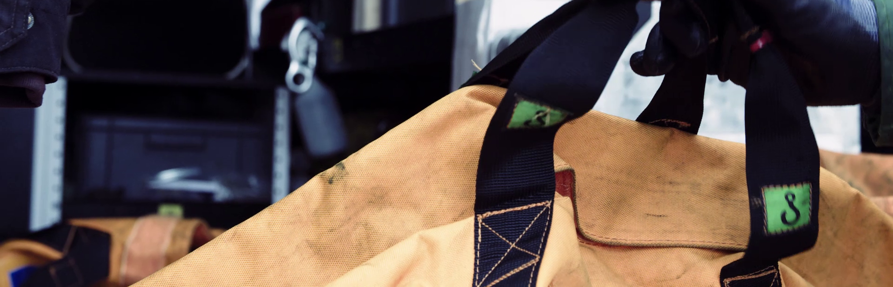
Toolbox Talk
What is Manual Handling?
1. What happened?

Slide 8
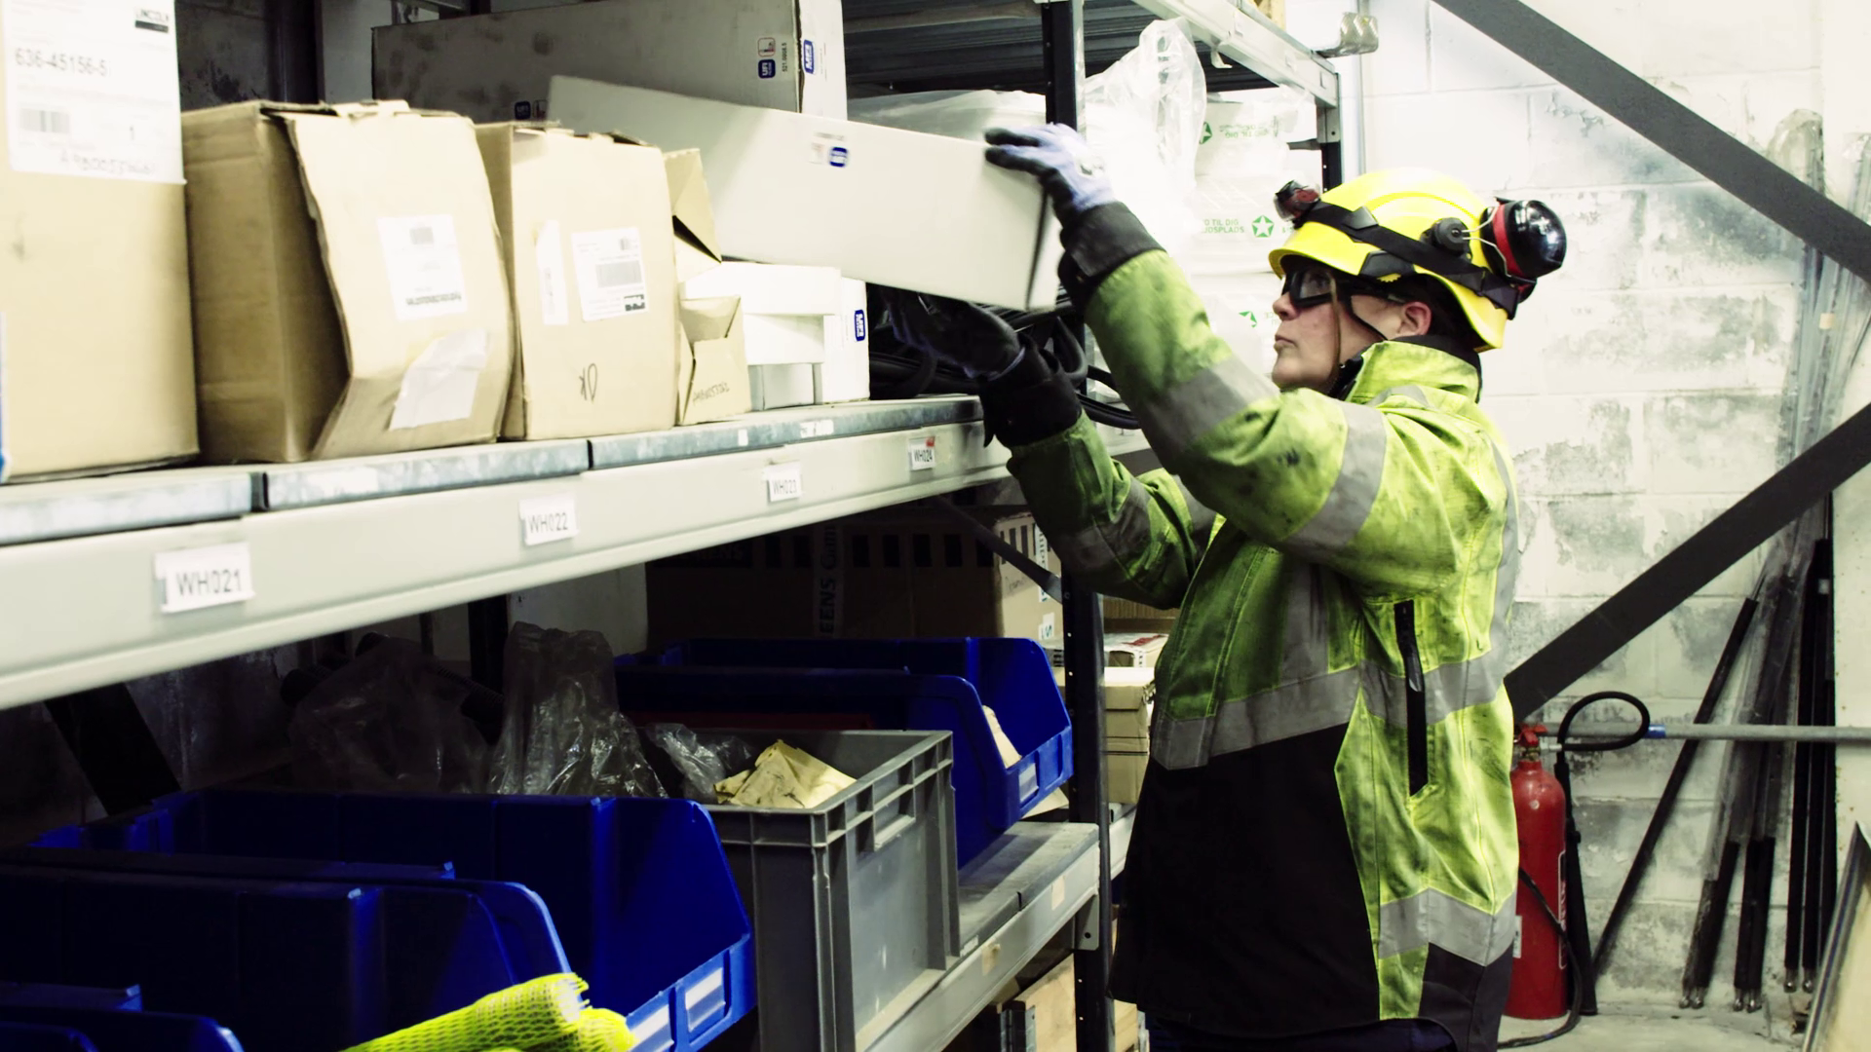
Toolbox Talk
What is Manual Handling?
2. Why did it happen?

Slide 9
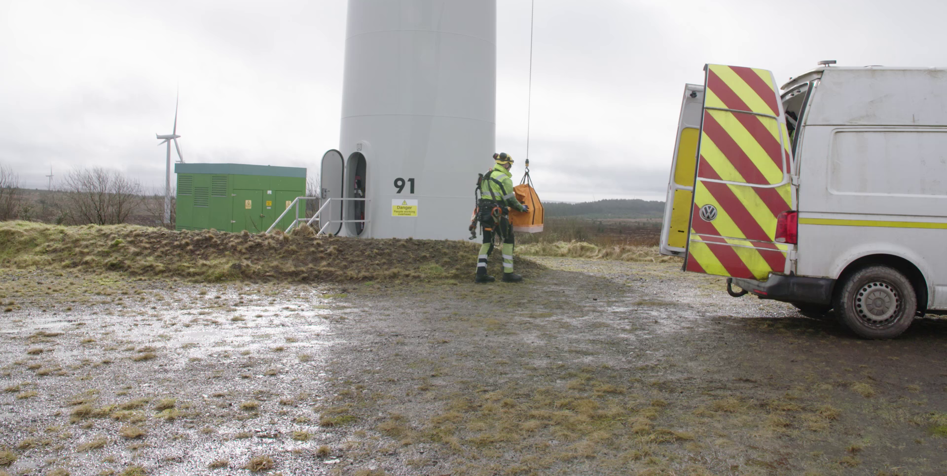
Toolbox Talk
What is Manual Handling?
3. What did they learn?

Slide 10
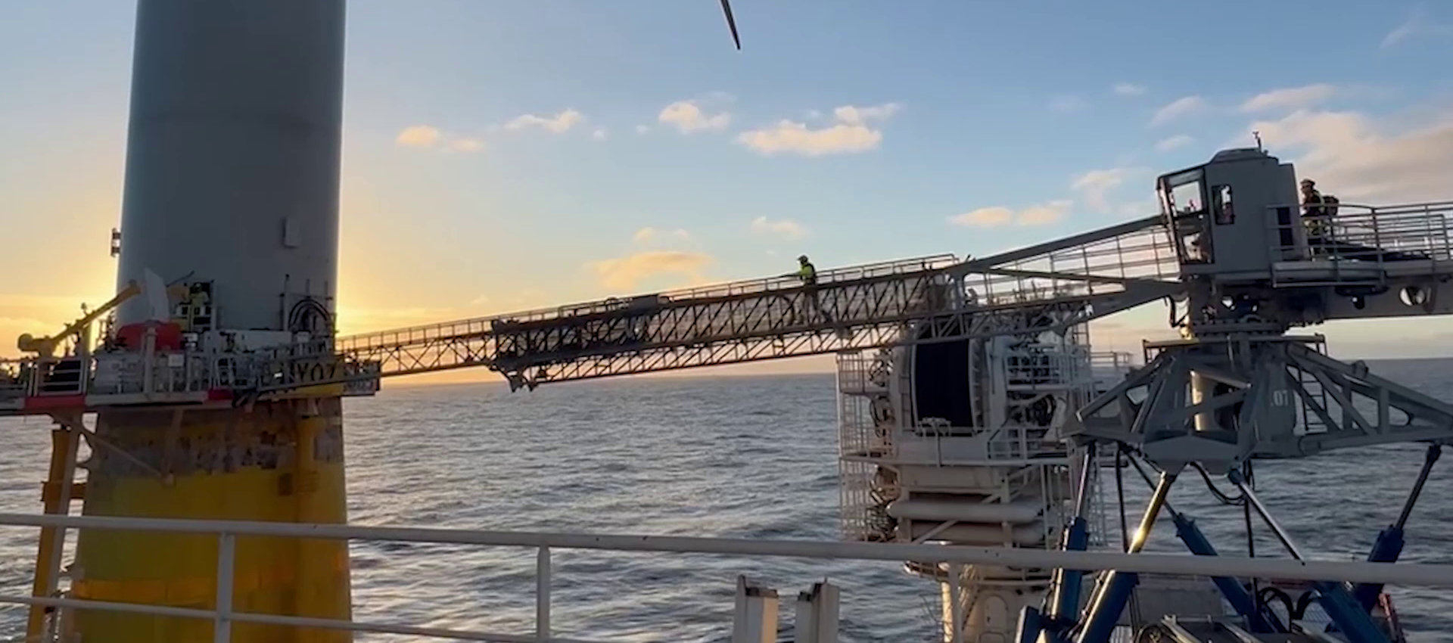
Toolbox Talk
What is Manual Handling?
4. Ask yourself or your crew?

Slide 11
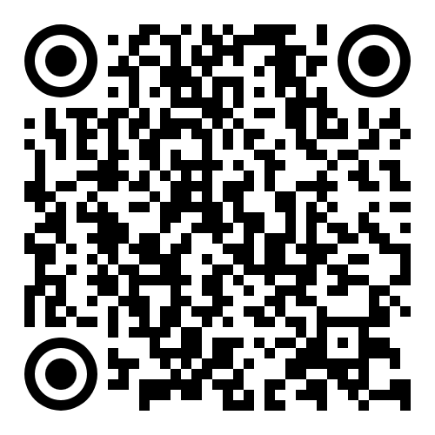
www.safetyon.com
@SafetyOnTweets
@SafetyOn
safetyon@energyinst.org
www.gplusoffshorewind.com
@gplusglobalofw
@G+ Global Offshore Wind Health and Safety Organisation
gplus@energyinst.org
Sign up for our newsletters

