Slide 1
In partnership with:

Slide 2
Stand Up for Safety Week is dedicated to creating time to discuss hazards working onshore and preventative measures that could be taken to reduce risk to health and safety.
#StandUpForSafety

Slide 3
About SafetyOn
Inspiring a safer and healthier onshore wind industry.
Providing advice, sharing best industry practice, promoting, innovation and creating positive change in the UK and Ireland’s onshore wind industry
Notes:
Provide health and safety leadership across the onshore wind industry
Seek participation of companies from across the onshore wind industry and partner with relevant trade organisations, consultancies and others
Monitor and gather data on the health and safety performance of the industry
Make use of and ensure effective communication of new and existing good practice and experience both from the UK, Ireland and internationally
Share knowledge and good practice with associated industries, including offshore wind, conventional generation and power networks, in the UK, Ireland and beyond as appropriate

Slide 4
Recognise Remove Redesign
#StandUpForSafety

Slide 5
Toolbox Talk
1. What happened?
Notes:
Hand injuries are the most frequent injured body part in the onshore wind industry. Like all injuries – they range in severity. It is important to remember that there are also invisible injuries caused through poor manual handling technique which can cause a lot of pain and discomfort and put you out of work for months at a time. For example: Upper limb disorders; Carpal tunnel disorder, and Hand Arm Vibration.

Slide 6
Toolbox Talk
2. Why did it happen?
Notes:
Poor manual handling technique
Not thinking of the environment, you are working in
Little attention to Recognising, Removing and Redesigning to reduce risk and mitigate injuries

Slide 7
Toolbox Talk
3. What did they learn?
Notes:
To protect yourself and your colleagues from injuries – apply these three key concepts:
Recognise the risks
Remove the hazards
Redesign your environment and processes when required
Always think about what you are doing
Care for your hands, look after them
If you have any doubt about what you are about to do, take a step back and give yourself more time to think

Slide 8
Toolbox Talk
4. Ask yourself or your crew?
Notes:
What are the hazards in your environment and how can you prevent injury from these things?
How can something like this happen here?
How can we protect you and your colleagues from hand injuries?

Slide 9
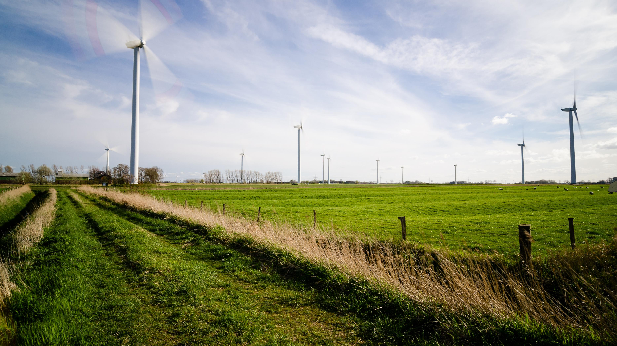
Find out more
www.safetyon.com
Sign up for our newsletter:
#StandUpForSafety

