Slide 1
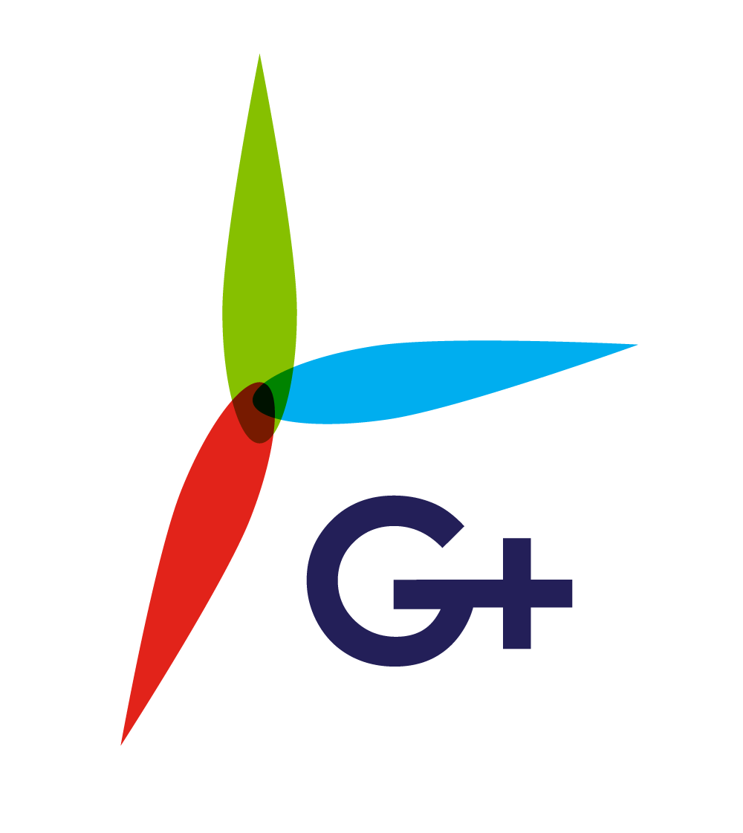
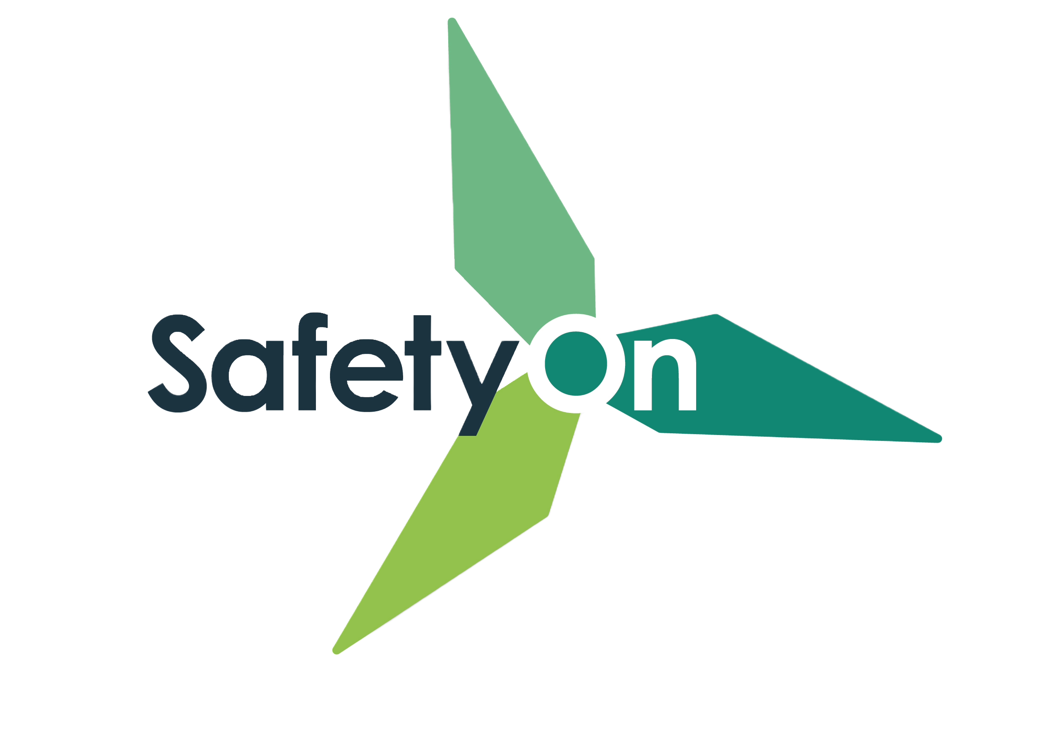
Addressing Manual Handling in the Wind Industry
Toolbox Talk 1: What is Manual Handling?

Slide 2
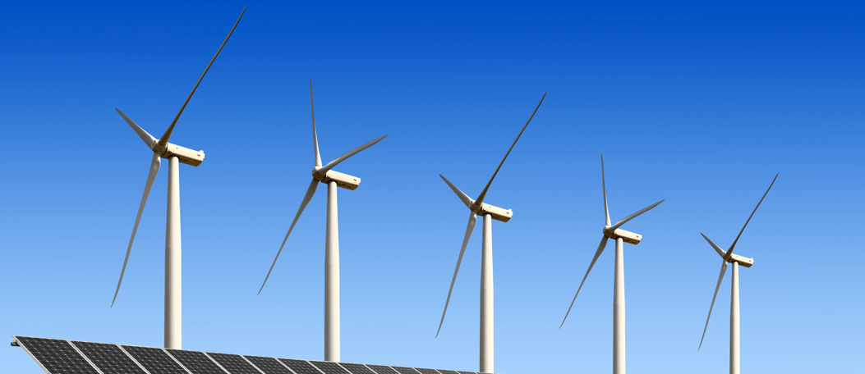
About SafetyOn
About G+
Inspiring a safer and healthier onshore wind industry
Global Offshore Wind Health and Safety Organisation
Providing advice, sharing best industry practice, promoting, innovation and creating positive change in the UK and Ireland’s onshore wind industry
Driving world class health and safety performance through collaboration on incident reporting, good practice, improving design safety and sharing lessons from incidents
Find out more at safetyon.com
Find out more at gplusoffshorewind.com
Notes:
SafetyOn
Provide health and safety leadership across the onshore wind industry
Seek participation of companies from across the onshore wind industry and partner with relevant trade organisations, consultancies and others
Monitor and gather data on the health and safety performance of the industry
Make use of and ensure effective communication of new and existing good practice and experience both from the UK, Ireland and internationally
Share knowledge and good practice with associated industries, including offshore wind, conventional generation and power networks, in the UK, Ireland and beyond as appropriate
G+
G+ is the global health and safety organisation, bringing together the offshore wind industry to pursue shared goals and outcomes. It is run in partnership with the Energy Institute, which provides the secretariat and supports its work.
The G+ main work areas:
Incident data reporting
Good practice guidance
Safe by Design workshops
Learning from incidents
Wind Turbine Safety Rules
Lifesaving Rules

Slide 3
Why manual handling?
Manual handling encompasses a wide range of incidents, with many crossovers and misconceptions. It is the leading cause of injuries in the wind industry, both on and offshore.
This video campaign aims to illustrate these incidents, suggesting good practice, rooted on actual on-site experience and reflective of all phases of projects both for the onshore and offshore wind industry.

Slide 5
What is Manual Handling?

Slide 6
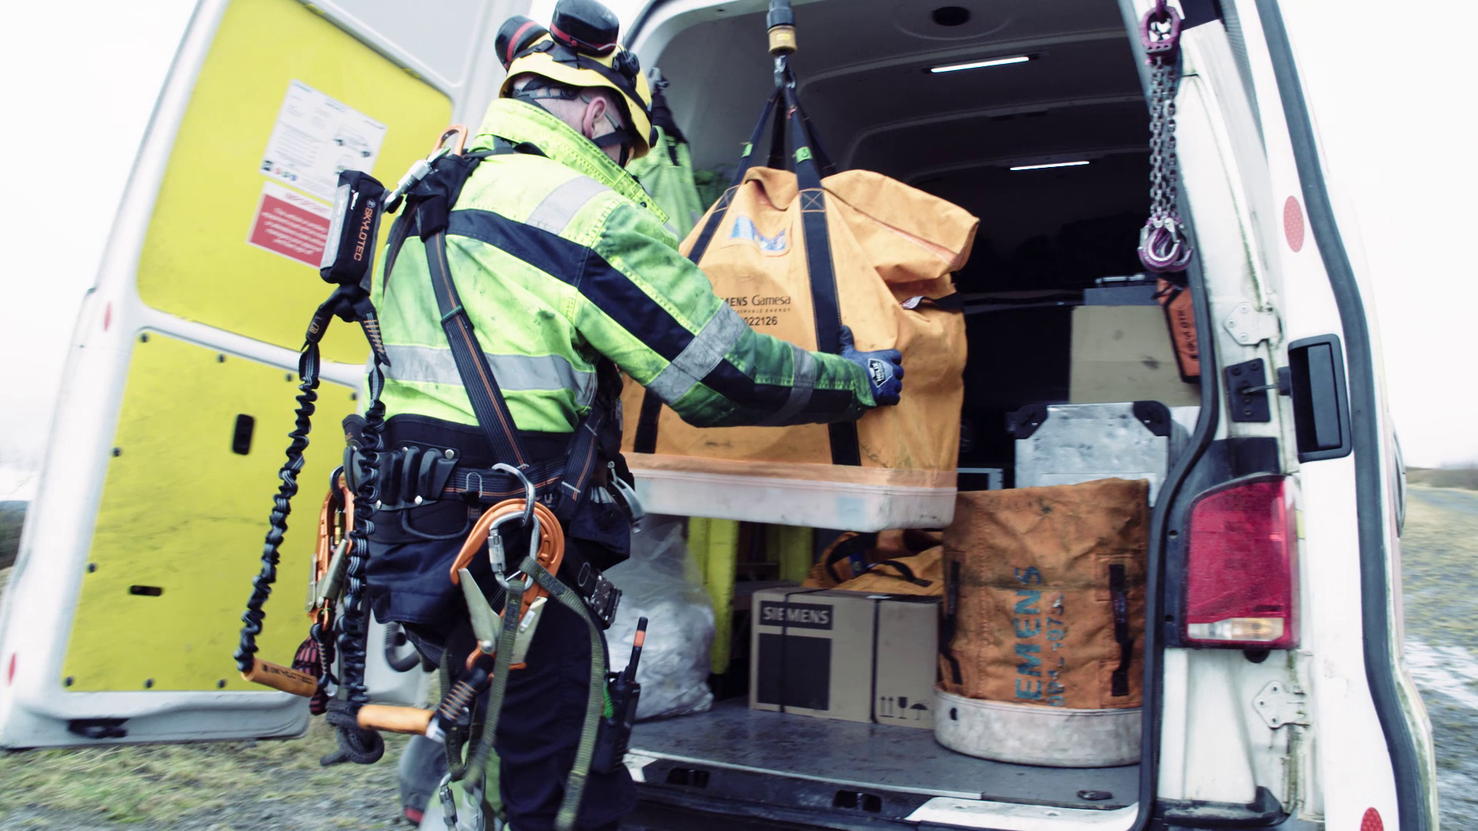
Toolbox Talk
What is Manual Handling?
Where do you encounter manual handling in your work tasks?
Why do you think it is the leading cause of injuries?
How can we keep each other safe regarding manual handling in the workplace?
What can be challenging about recognising and act on manual handling risks?
Have you ever experienced a manual handling injury, or a close call?
Notes:
Additional questions to encourage discussion:
Do you agree with their definitions of manual handling? What else would you add?
Why do you make considerations in your day-to-day? Do you have personal considerations?
What have you or others done to reduce potential manual handling incidents?
Have you seen this at work? How would a manual handling culture be reflected?
If a scenario is shared, the following slides “Toolbox Talk” could be used to discuss the incident.

Slide 7
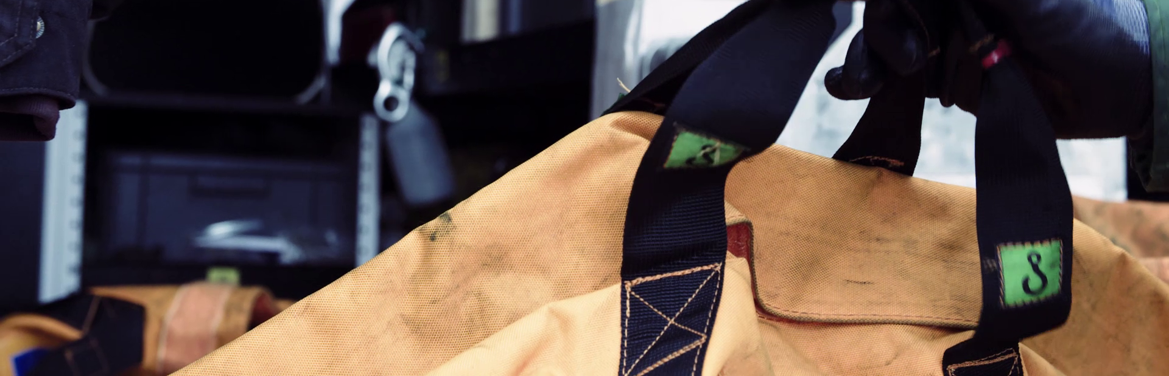
Toolbox Talk
What is Manual Handling?
1. What happened?

Slide 8
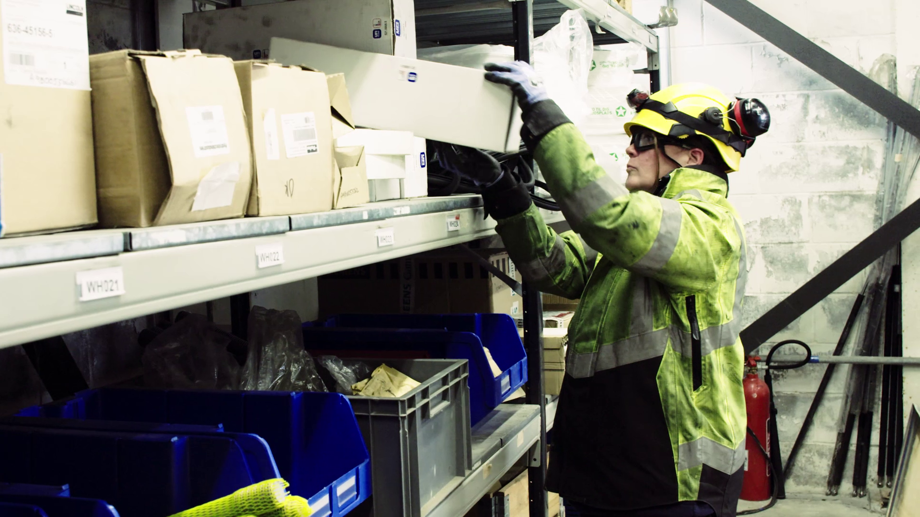
Toolbox Talk
What is Manual Handling?
2. Why did it happen?

Slide 9
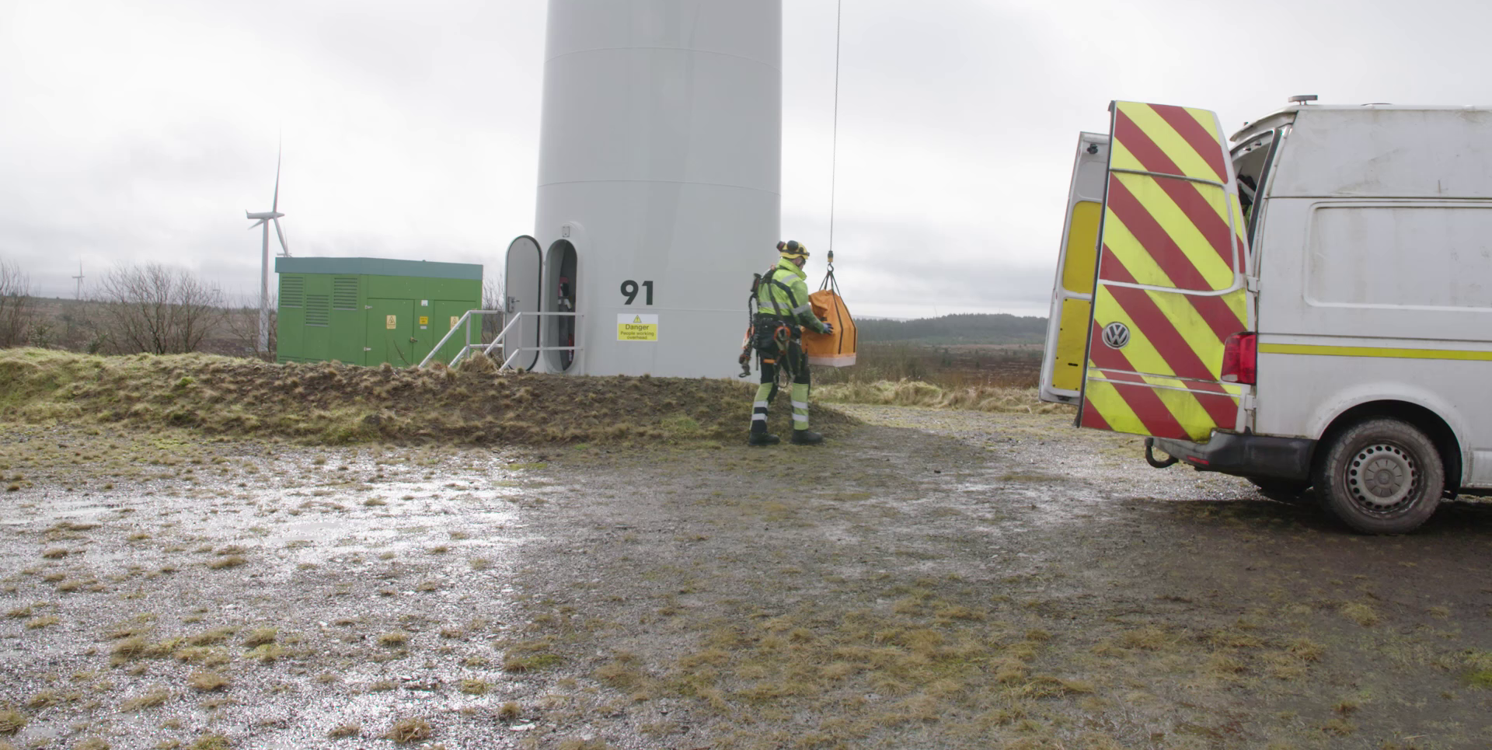
Toolbox Talk
What is Manual Handling?
3. What did they learn?

Slide 10
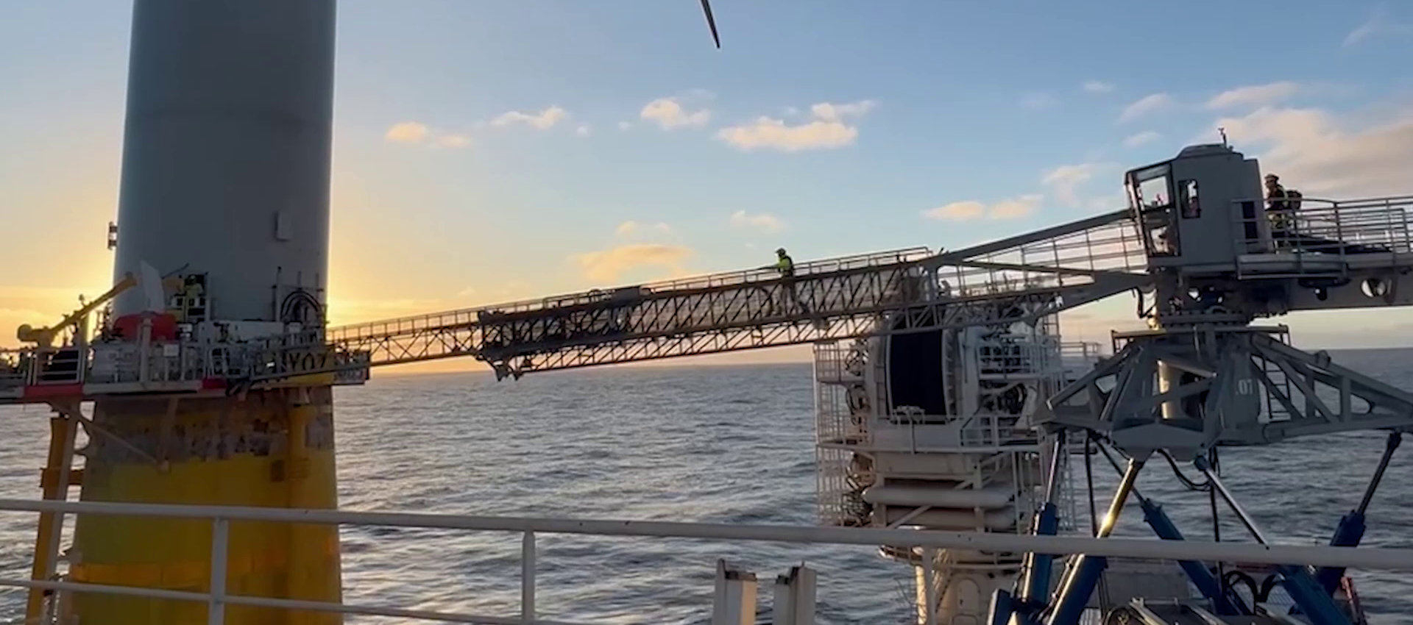
Toolbox Talk
What is Manual Handling?
4. Ask yourself or your crew?

Slide 11
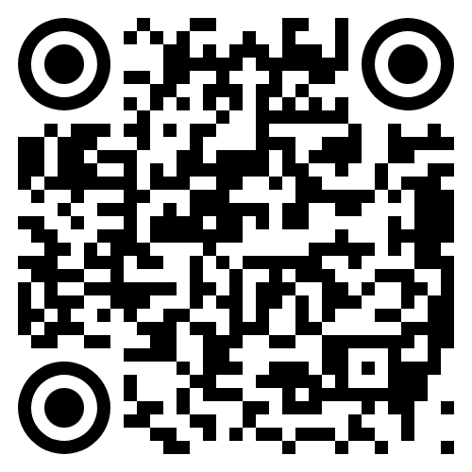
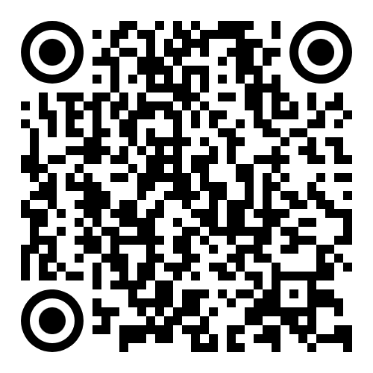
www.safetyon.com
@SafetyOnTweets
@SafetyOn
safetyon@energyinst.org
www.gplusoffshorewind.com
@gplusglobalofw
@G+ Global Offshore Wind Health and Safety Organisation
gplus@energyinst.org
Sign up for our newsletters

Slide 12
Addressing Manual Handling in the Wind Industry
Toolbox Talk 2: The incident

Slide 13
About SafetyOn
About G+
Inspiring a safer and healthier onshore wind industry
Global Offshore Wind Health and Safety Organisation
Providing advice, sharing best industry practice, promoting, innovation and creating positive change in the UK and Ireland’s onshore wind industry
Driving world class health and safety performance through collaboration on incident reporting, good practice, improving design safety and sharing lessons from incidents
Find out more at safetyon.com
Find out more at gplusoffshorewind.com
Notes:
SafetyOn
Provide health and safety leadership across the onshore wind industry
Seek participation of companies from across the onshore wind industry and partner with relevant trade organisations, consultancies and others
Monitor and gather data on the health and safety performance of the industry
Make use of and ensure effective communication of new and existing good practice and experience both from the UK, Ireland and internationally
Share knowledge and good practice with associated industries, including offshore wind, conventional generation and power networks, in the UK, Ireland and beyond as appropriate
G+
G+ is the global health and safety organisation, bringing together the offshore wind industry to pursue shared goals and outcomes. It is run in partnership with the Energy Institute, which provides the secretariat and supports its work.
The G+ main work areas:
Incident data reporting
Good practice guidance
Safe by Design workshops
Learning from incidents
Wind Turbine Safety Rules
Lifesaving Rules

Slide 14
Why manual handling?
Manual handling encompasses a wide range of incidents, with many crossovers and misconceptions. It is the leading cause of injuries in the wind industry, both on and offshore.
This video campaign aims to illustrate these incidents, suggesting good practice, rooted on actual on-site experience and reflective of all phases of projects both for the onshore and offshore wind industry.

Slide 16
The incident

Slide 17
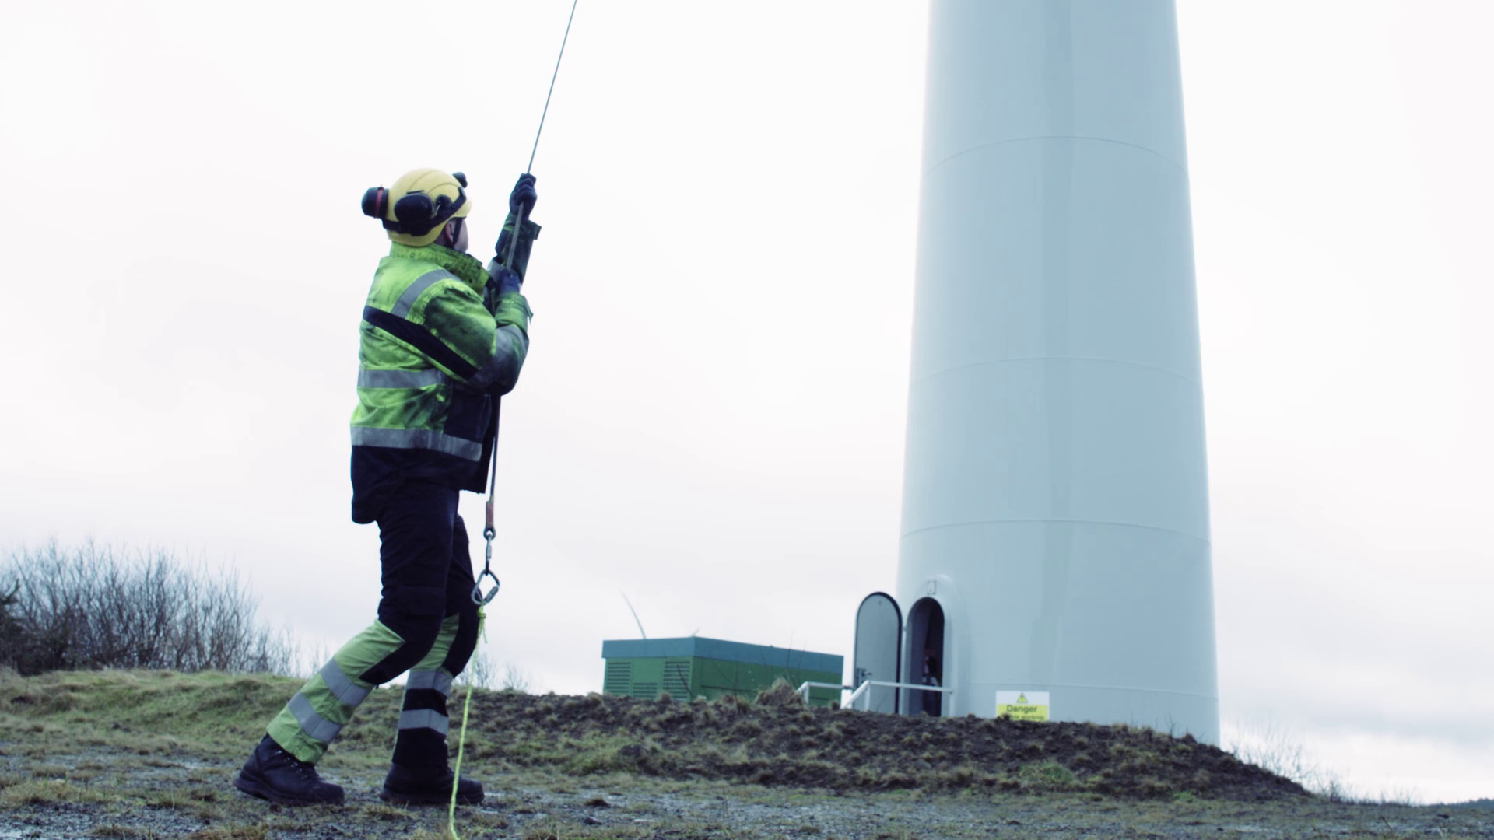
Toolbox Talk
The incident
1. What happened?
Notes:
Further discussion questions:
What was the context?
How do you think Ian felt when he failed his medical, why?
Short-term?
Long-term?
Could this happen to you/someone in your team?

Slide 18
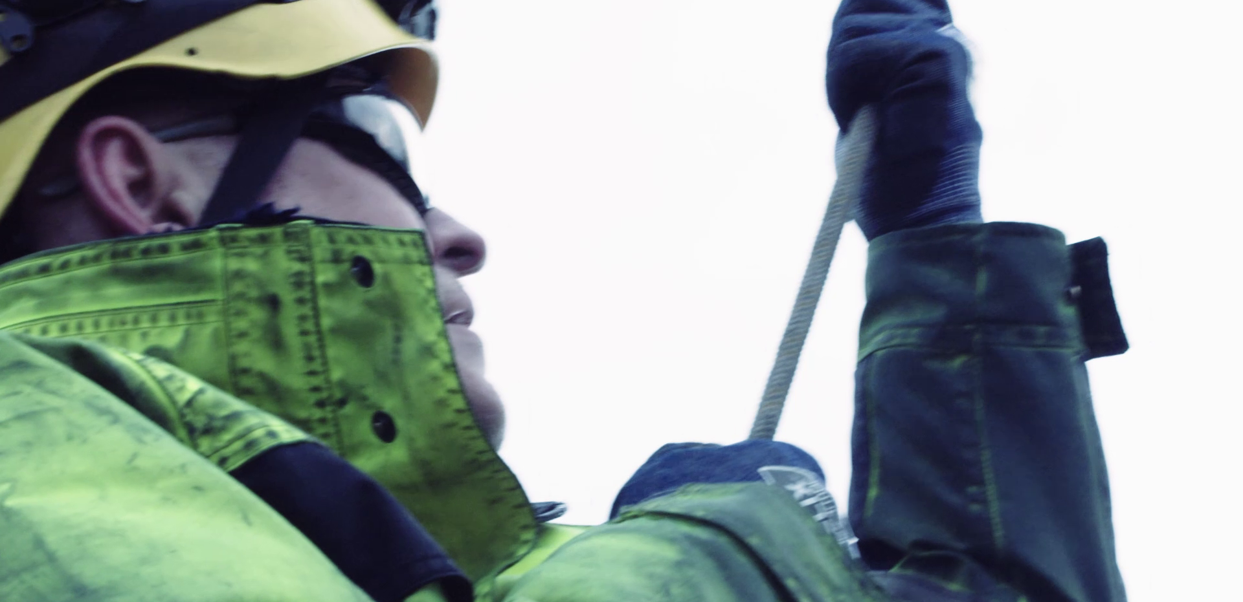
Toolbox Talk
The incident
2. Why did it happen?
Notes:
Further discussion questions:
1. Were there external pressures? Time? Weather? Short-staffed? How could these factors have impacted the incident?

Slide 19
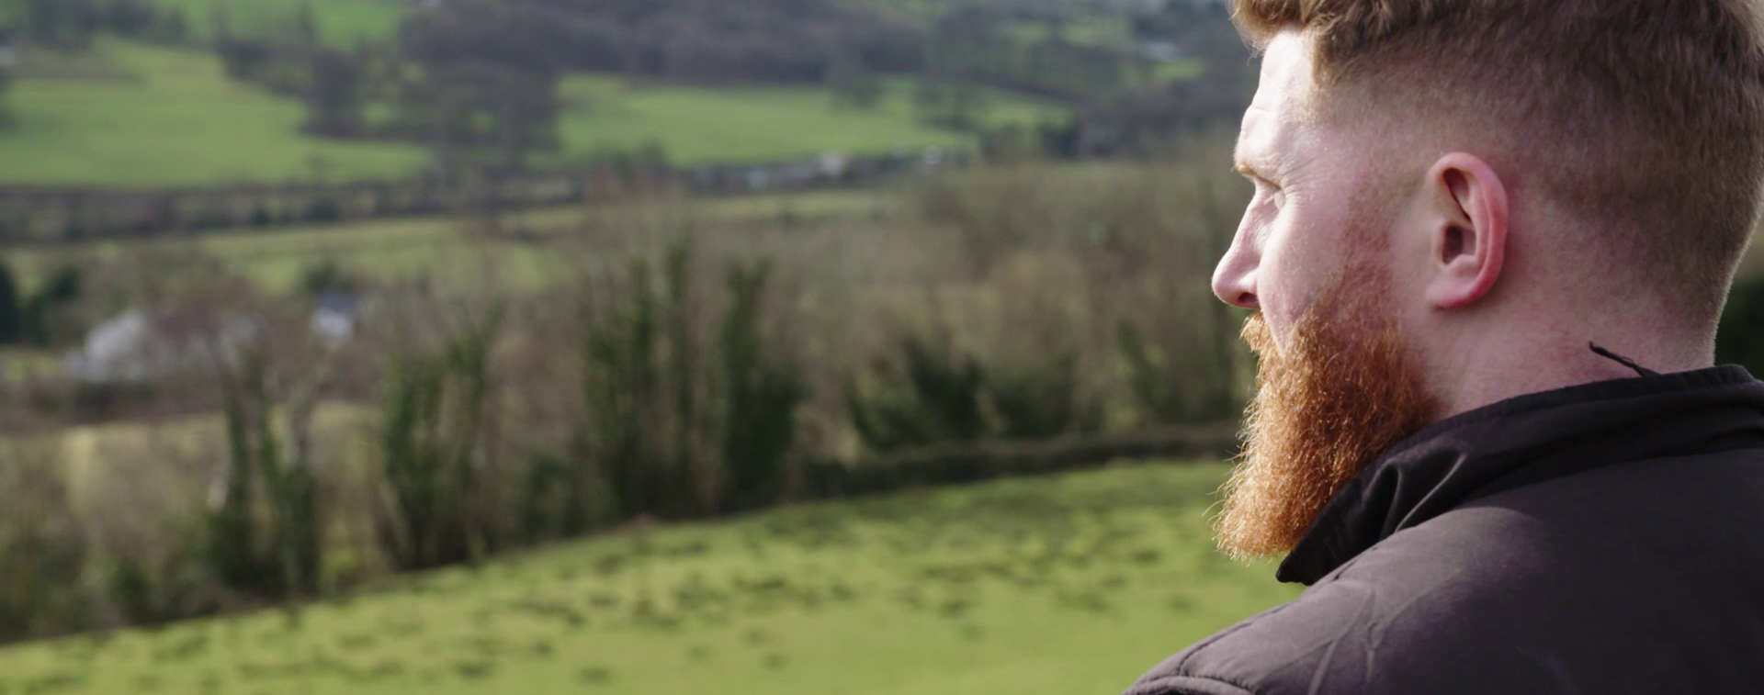
Toolbox Talk
The incident
3. What did they learn?
Notes:
Further discussion questions:
How could Ian's company and colleagues have supported him better at the time? Think, at the time of the incident, in the days/weeks after, when he failed his medical?
What could have been done to prevent this injury?

Slide 20
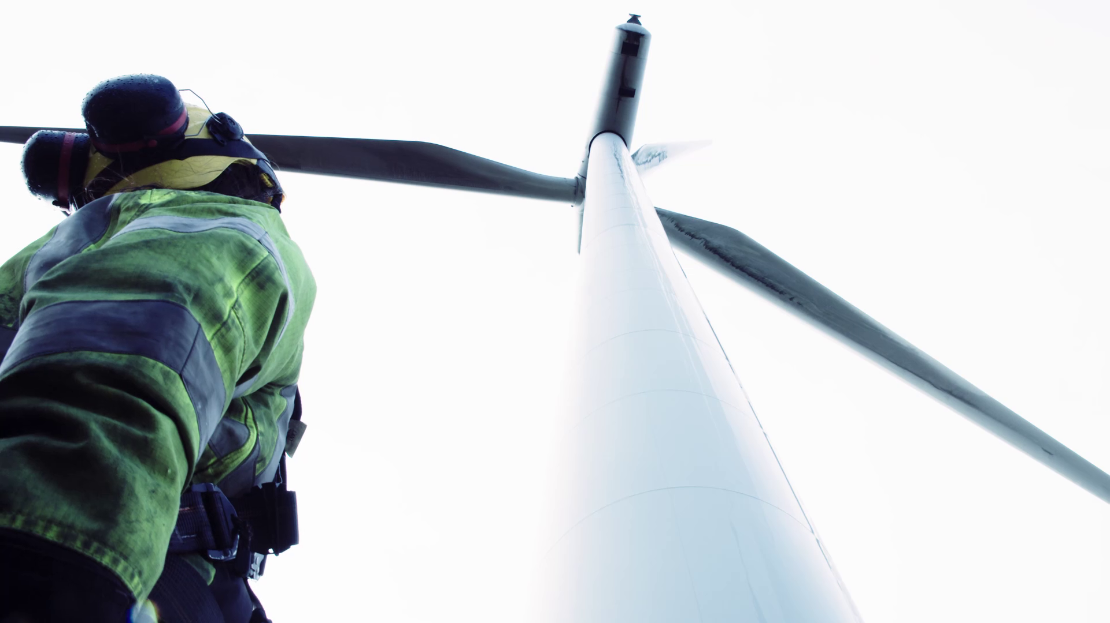
Toolbox Talk
The incident
4. Ask yourself or your crew?
Notes:
Further discussion questions:
Could this happen on-site?
How could it be prevented?
What should you look out for on-site to avoid this happening to you/your team?

Slide 21
www.safetyon.com
@SafetyOnTweets
@SafetyOn
safetyon@energyinst.org
www.gplusoffshorewind.com
@gplusglobalofw
@G+ Global Offshore Wind Health and Safety Organisation
gplus@energyinst.org
Sign up for our newsletters

Slide 22
Addressing Manual Handling in the Wind Industry
Toolbox Talk 3: Designing out risk

Slide 23
About SafetyOn
About G+
Inspiring a safer and healthier onshore wind industry
Global Offshore Wind Health and Safety Organisation
Providing advice, sharing best industry practice, promoting, innovation and creating positive change in the UK and Ireland’s onshore wind industry
Driving world class health and safety performance through collaboration on incident reporting, good practice, improving design safety and sharing lessons from incidents
Find out more at safetyon.com
Find out more at gplusoffshorewind.com
Notes:
SafetyOn
Provide health and safety leadership across the onshore wind industry
Seek participation of companies from across the onshore wind industry and partner with relevant trade organisations, consultancies and others
Monitor and gather data on the health and safety performance of the industry
Make use of and ensure effective communication of new and existing good practice and experience both from the UK, Ireland and internationally
Share knowledge and good practice with associated industries, including offshore wind, conventional generation and power networks, in the UK, Ireland and beyond as appropriate
G+
G+ is the global health and safety organisation, bringing together the offshore wind industry to pursue shared goals and outcomes. It is run in partnership with the Energy Institute, which provides the secretariat and supports its work.
The G+ main work areas:
Incident data reporting
Good practice guidance
Safe by Design workshops
Learning from incidents
Wind Turbine Safety Rules
Lifesaving Rules

Slide 24
Why manual handling?
Manual handling encompasses a wide range of incidents, with many crossovers and misconceptions. It is the leading cause of injuries in the wind industry, both on and offshore.
This video campaign aims to illustrate these incidents, suggesting good practice, rooted on actual on-site experience and reflective of all phases of projects both for the onshore and offshore wind industry.

Slide 26
Designing out risk

Slide 27
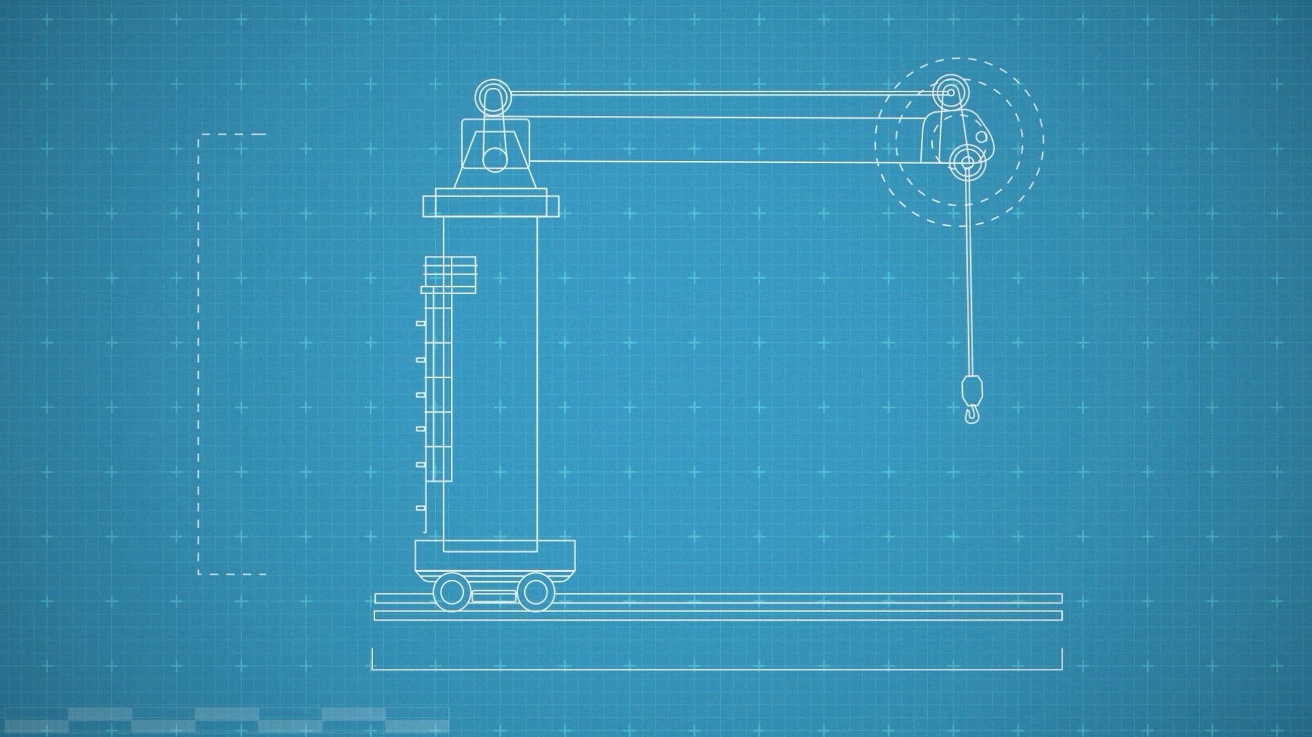
Toolbox Talk
Designing out risk
When have you discovered a design flaw on site, with manual handling implications?
What should you do if you find yourself unable to complete a task with the mechanical aids provided?
How would you feedback this information to improve future designs?
How could the team and company improve this feedback loop?
Notes:
Additional questions to encourage discussion:
Where was the design issue located? On the turbine? Vessel? Warehouse? What could be done about it?
What temporary solutions could be considered in the interim? How would you address it with your team? If there are no alternatives to alleviate the manual handling risk, what should you do? Could a task present a risk to specific individuals (eg if there is a height difference, for one example) what would you do then?
Who could you tell? If you communicate this with your supervisor (or equivalent), how should they feed it back up the chain to improve future designs? Have you seen this happen?
Do you feel the feedback loop is transparent enough? Is it possible to track the progress of your feedback? Do you feel comfortable sharing improvements with your team and superiors?

Slide 28
www.safetyon.com
@SafetyOnTweets
@SafetyOn
safetyon@energyinst.org
www.gplusoffshorewind.com
@gplusglobalofw
@G+ Global Offshore Wind Health and Safety Organisation
gplus@energyinst.org
Sign up for our newsletters

Slide 29
Addressing Manual Handling in the Wind Industry
Toolbox Talk 4: Risk assessment

Slide 30
About SafetyOn
About G+
Inspiring a safer and healthier onshore wind industry
Global Offshore Wind Health and Safety Organisation
Providing advice, sharing best industry practice, promoting, innovation and creating positive change in the UK and Ireland’s onshore wind industry
Driving world class health and safety performance through collaboration on incident reporting, good practice, improving design safety and sharing lessons from incidents
Find out more at safetyon.com
Find out more at gplusoffshorewind.com
Notes:
SafetyOn
Provide health and safety leadership across the onshore wind industry
Seek participation of companies from across the onshore wind industry and partner with relevant trade organisations, consultancies and others
Monitor and gather data on the health and safety performance of the industry
Make use of and ensure effective communication of new and existing good practice and experience both from the UK, Ireland and internationally
Share knowledge and good practice with associated industries, including offshore wind, conventional generation and power networks, in the UK, Ireland and beyond as appropriate
G+
G+ is the global health and safety organisation, bringing together the offshore wind industry to pursue shared goals and outcomes. It is run in partnership with the Energy Institute, which provides the secretariat and supports its work.
The G+ main work areas:
Incident data reporting
Good practice guidance
Safe by Design workshops
Learning from incidents
Wind Turbine Safety Rules
Lifesaving Rules

Slide 31
Why manual handling?
Manual handling encompasses a wide range of incidents, with many crossovers and misconceptions. It is the leading cause of injuries in the wind industry, both on and offshore.
This video campaign aims to illustrate these incidents, suggesting good practice, rooted on actual on-site experience and reflective of all phases of projects both for the onshore and offshore wind industry.

Slide 33
Risk assessment

Slide 34
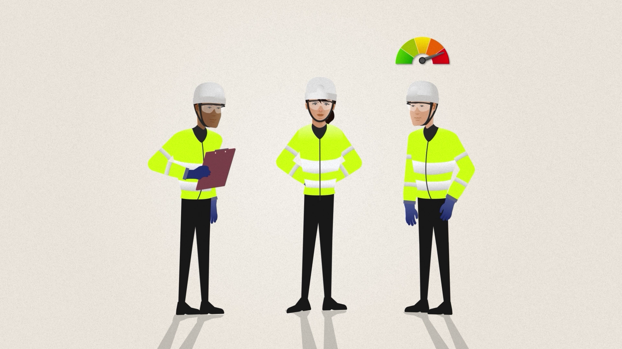
Toolbox Talk
Risk assessment
Where do you undertake dynamic risk assessments for manual handling tasks?
What external factors could increase the risk of a manual handling incident?
How might the manual handling risk differ between people, even for the same task?
When have you encouraged peers to stop and re-assess a manual handling risk?
Notes:
Additional questions to encourage discussion:
Think about your day-to-day tasks as well as the bigger risky jobs, do you get straight on with the job or stop and think first? What tasks come to mind?
How might the weather impact the risk of a task? What if the weather is great now but it has been raining? Other environmental factors? What about mental distractions, how might someone’s personal life increase their risk of a manual handling injury? Can fatigue impact the risk? What about the time of day or season?
Are we all built the same? How could previous injuries impact this risk? Think about how equipment is designed, is it suitable for all shapes and sizes? How can you look out for your peers in these scenarios?
Or, has a peer reminded you of manual handling risks? What did you say? What did they do? How did you feel? Would you feel comfortable doing this at work? How can we encourage a culture of positive reflection and correction in the workplace?

Slide 35
www.safetyon.com
@SafetyOnTweets
@SafetyOn
safetyon@energyinst.org
www.gplusoffshorewind.com
@gplusglobalofw
@G+ Global Offshore Wind Health and Safety Organisation
gplus@energyinst.org
Sign up for our newsletters

