Slide 1
In partnership with:

Slide 2
Stand Up for Safety Week is dedicated to creating time to discuss hazards working onshore and preventative measures that could be taken to reduce risk to health and safety.
#StandUpForSafety

Slide 3
About SafetyOn
Inspiring a safer and healthier onshore wind industry
We work to:
Monitor and gather data on the health and safety performance of the sector
Make use of and ensure effective communication of new and existing good practice and experience both from the UK and internationally
Share knowledge and good practice with associated sectors, including offshore wind, conventional generation and power networks, in the UK and beyond as appropriate
Notes:
Provide health and safety leadership across the onshore wind sector
Seek participation of companies from across the onshore wind sector and partner with relevant trade organisations, consultancies and others
Monitor and gather data on the health and safety performance of the sector
Make use of and ensure effective communication of new and existing good practice and experience both from the UK and internationally
Share knowledge and good practice with associated sectors, including offshore wind, conventional generation and power networks, in the UK and beyond as appropriate

Slide 4
Safe Journeys Campaign
#StandUpForSafety
Notes:
https://toolbox.energyinst.org/c/videos/safe-journey

Slide 5
Toolbox Talk
1. What happened?
Notes:
The video aims to raise awareness of the consequences of risky overtaking manoeuvres, which account for a significant proportion of fatal crashes.
In the incident, the truck that was overtaking another vehicle on a downhill slope. Approaching a bend in the road, the truck crashed frontally with a car, killing 2 adults.
The only survivor from the car was an 11-month baby.

Slide 6
Toolbox Talk
2. Why did it happen?
Notes:
The driver overtook on a downhill slope, overtaking alongside the other truck for longer that the driver expected to be.
Driving on the wrong side of the road with no sight of the oncoming traffic, the trucks went round two bends before seeing the oncoming car.
Braking on a wet surface, the truck’s wheels locked. The overtaking truck then struck the car on the bend.

Slide 7
Toolbox Talk
3. What did they learn?
Notes:
The passenger should have said something to the driver, when the dangerous manoeuvre took place.
The driver failed to safely assess whether it was safe to overtake. They failed to account for the inability to overtake on a downhill slope, the wet weather conditions, as well as the blind corners that were upcoming.

Slide 8
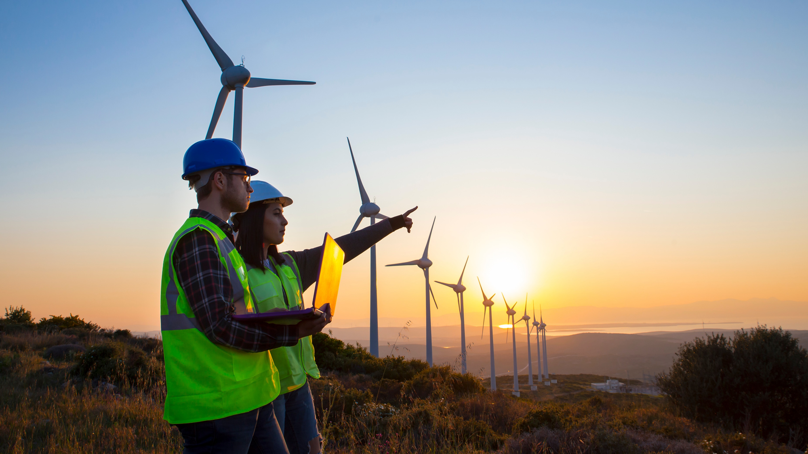
Toolbox Talk
4. Ask yourself or your crew?
Notes:
How much are you willing to risk to get there on time?
What is causing us to feel like we need to rush journeys?
What can we change to make sure we always have safe journeys?

